Slide 1



A Gamified Additive Cognitive Control Paradigm for Computational Neuropsychology
Notes:
Not your typical scientific presentation but instead the story of this project

Slide 2

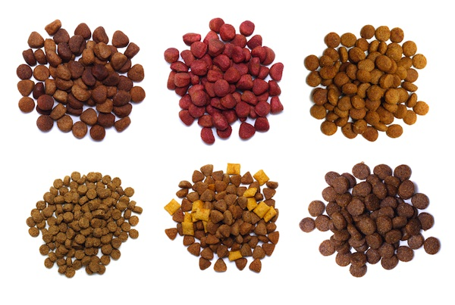
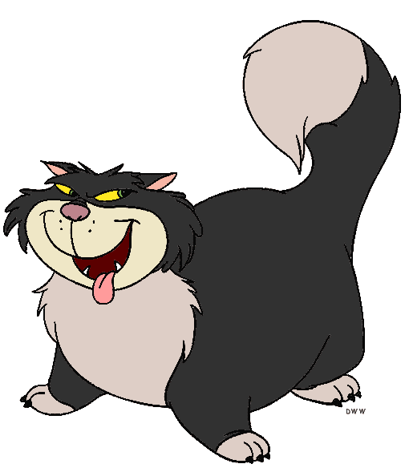

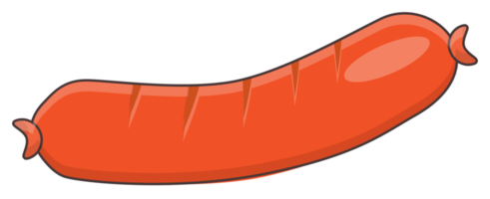
Doggo / Nogo
An idea

Slide 3

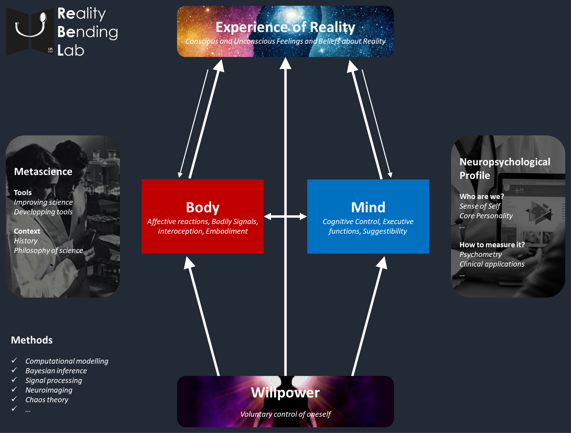
The lab investigates the contribution of cognitive and embodied processes (and their interaction) in the perception of reality.
In particular, the role of « cognitive control »
This requires us to have good tools
Project Goal
Develop an engaging, reliable, comprehensive paradigm for cognitive control
To be used as an neuropsychological index (correlate with other dispositional characteristics / assessment)
To investigate the role of interoceptive mechanisms
To better understand the unicity/diversity of executive functions

Slide 4
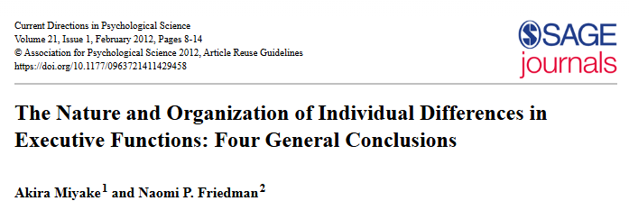
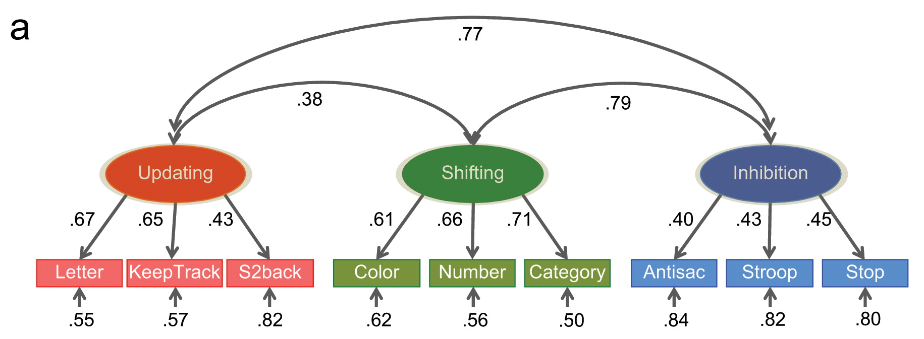
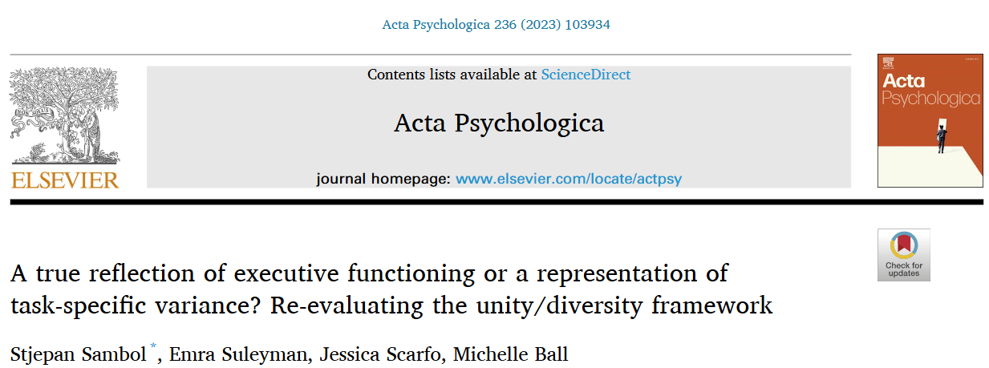
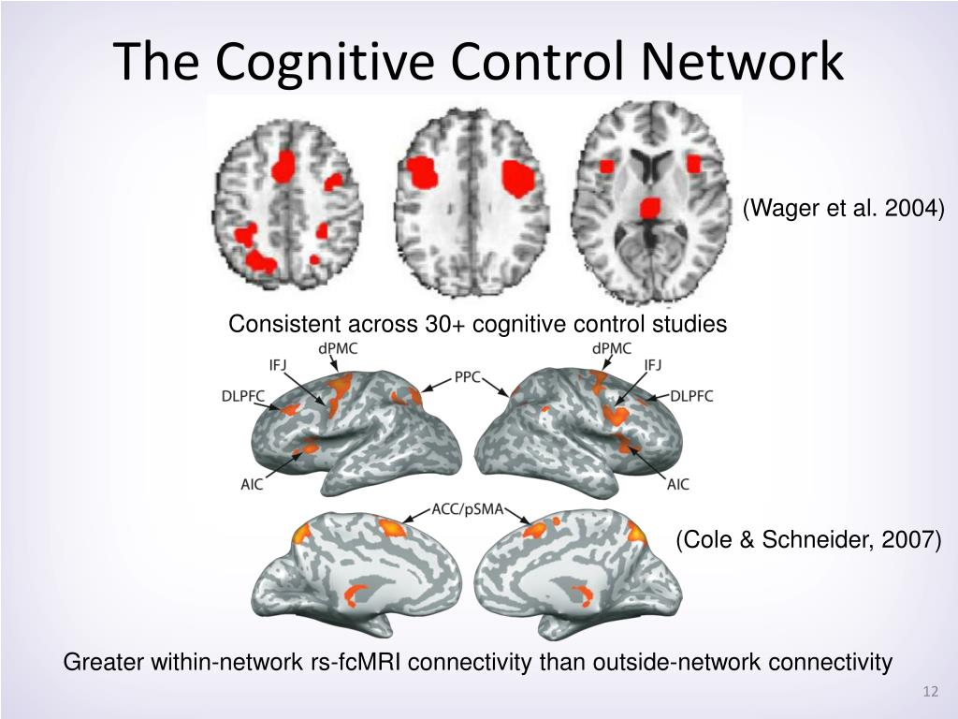
Why measure Cognitive Control?
« Cognitive Control » is a critical cognitive function and its impairment a transdiagnostic symptom
It is not a unitary construct but refers to a variety of mechanisms
Processing speed
Inhibition (motor inhibition, response inhibition, …)
Conflict (conflict monitoring, conflict resolution, …)
Mental set shifting (task rules inhibition and switching, …)
Working memory (short term memory, updating, …)
Attention and attentional control
Multiple tasks exist to measure them (Stroop, flanker, Simon, Go/Nogo, Stop-signal, ANT, …)
Problems
Validity problems (unicity/diversity of EFs)
Low psychometric-to-behavior predictive power
Low brain-behaviour correlations
Low correlation between various tasks
Cause
Underpowered studies: Not enough large samples with comprehensive batteries difficult for norms and structure analysis
Low reliability of tasks (Rouder et al.,)
…
Solution(s)
Better analysis approaches (e.g., mixed models, decision making models – aka « Sequential Sampling Models »)
Better experience
More engaging tasks (gamification?)
Better paradigms:
More controlled manipulations (better « control » conditions, etc.)
More systematic and sequential (additive) quantification procedure
Notes:
A true reflection of executive functioning or a representation of task-specific variance? Re-evaluating the unity/diversity framework - ScienceDirect
- “Not enough trials”: false solution as adding more trials in these taxing tasks doesn’t necessarily improve reliability

Slide 5
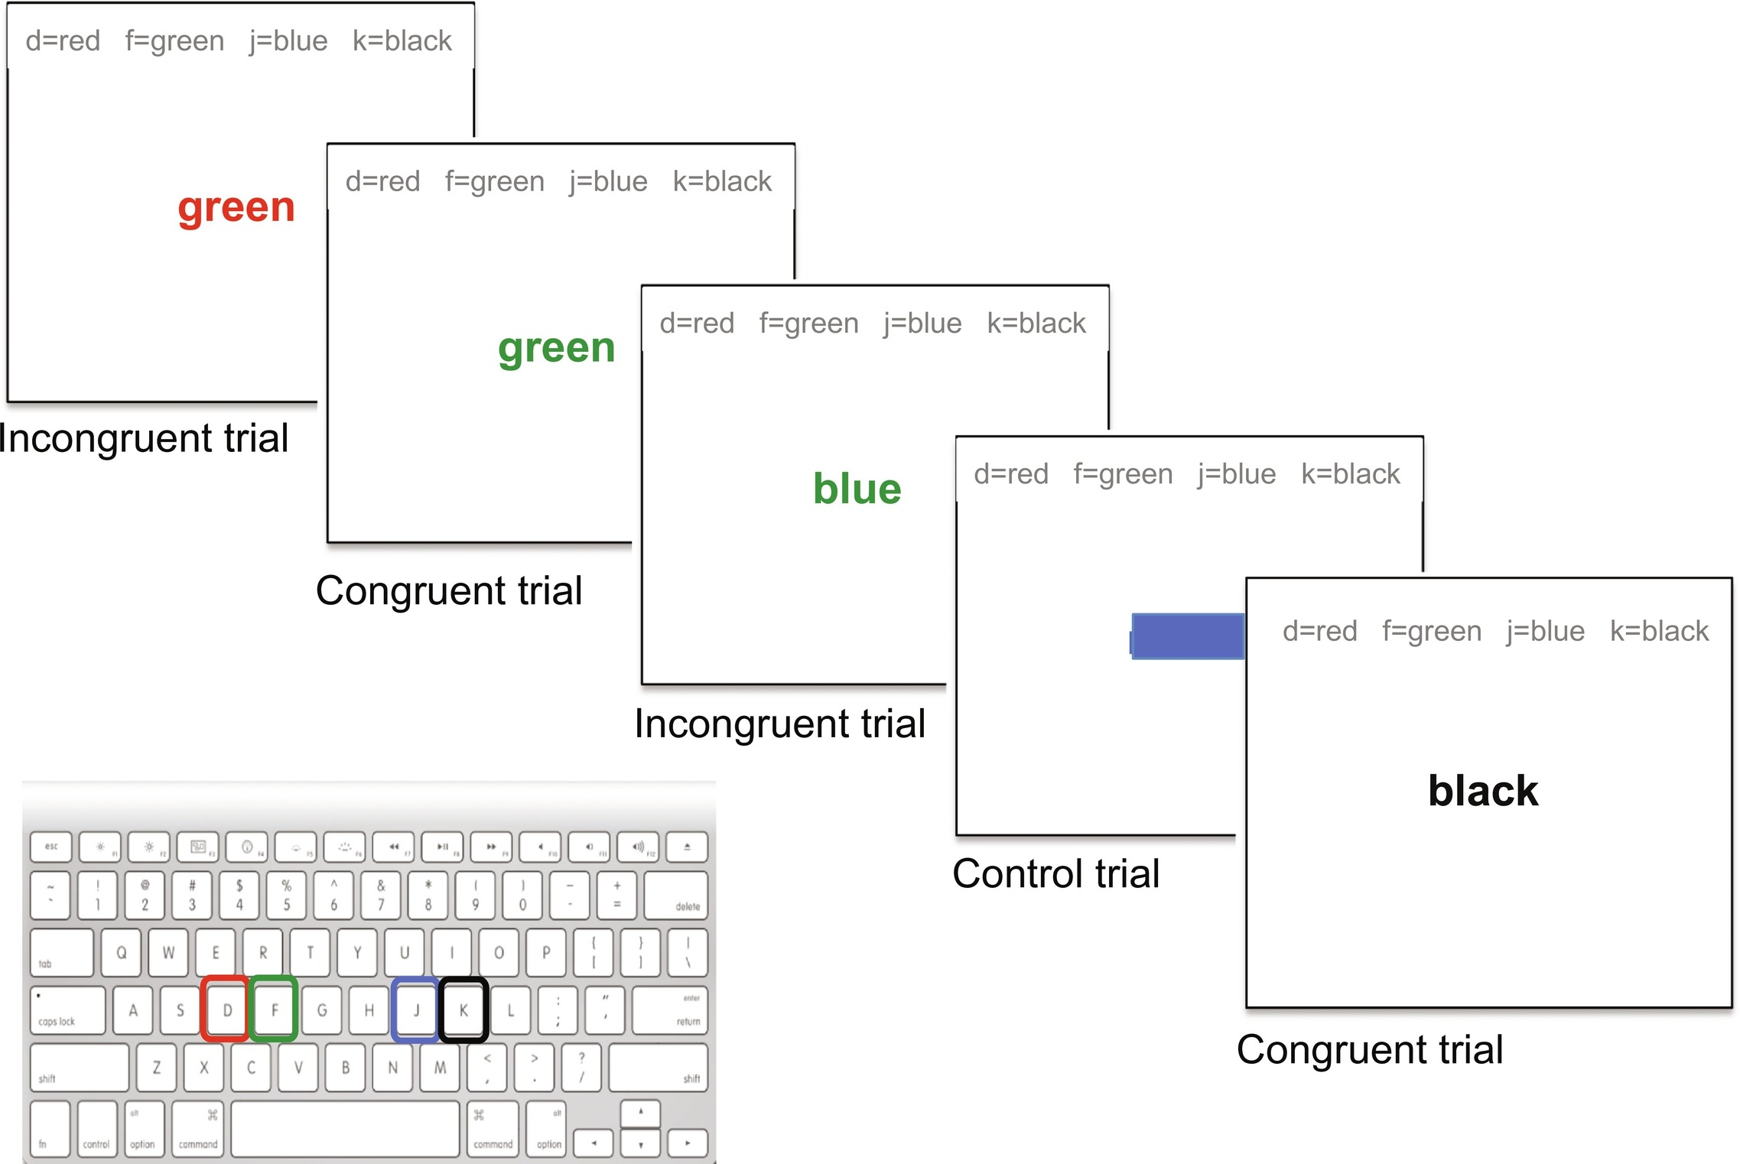
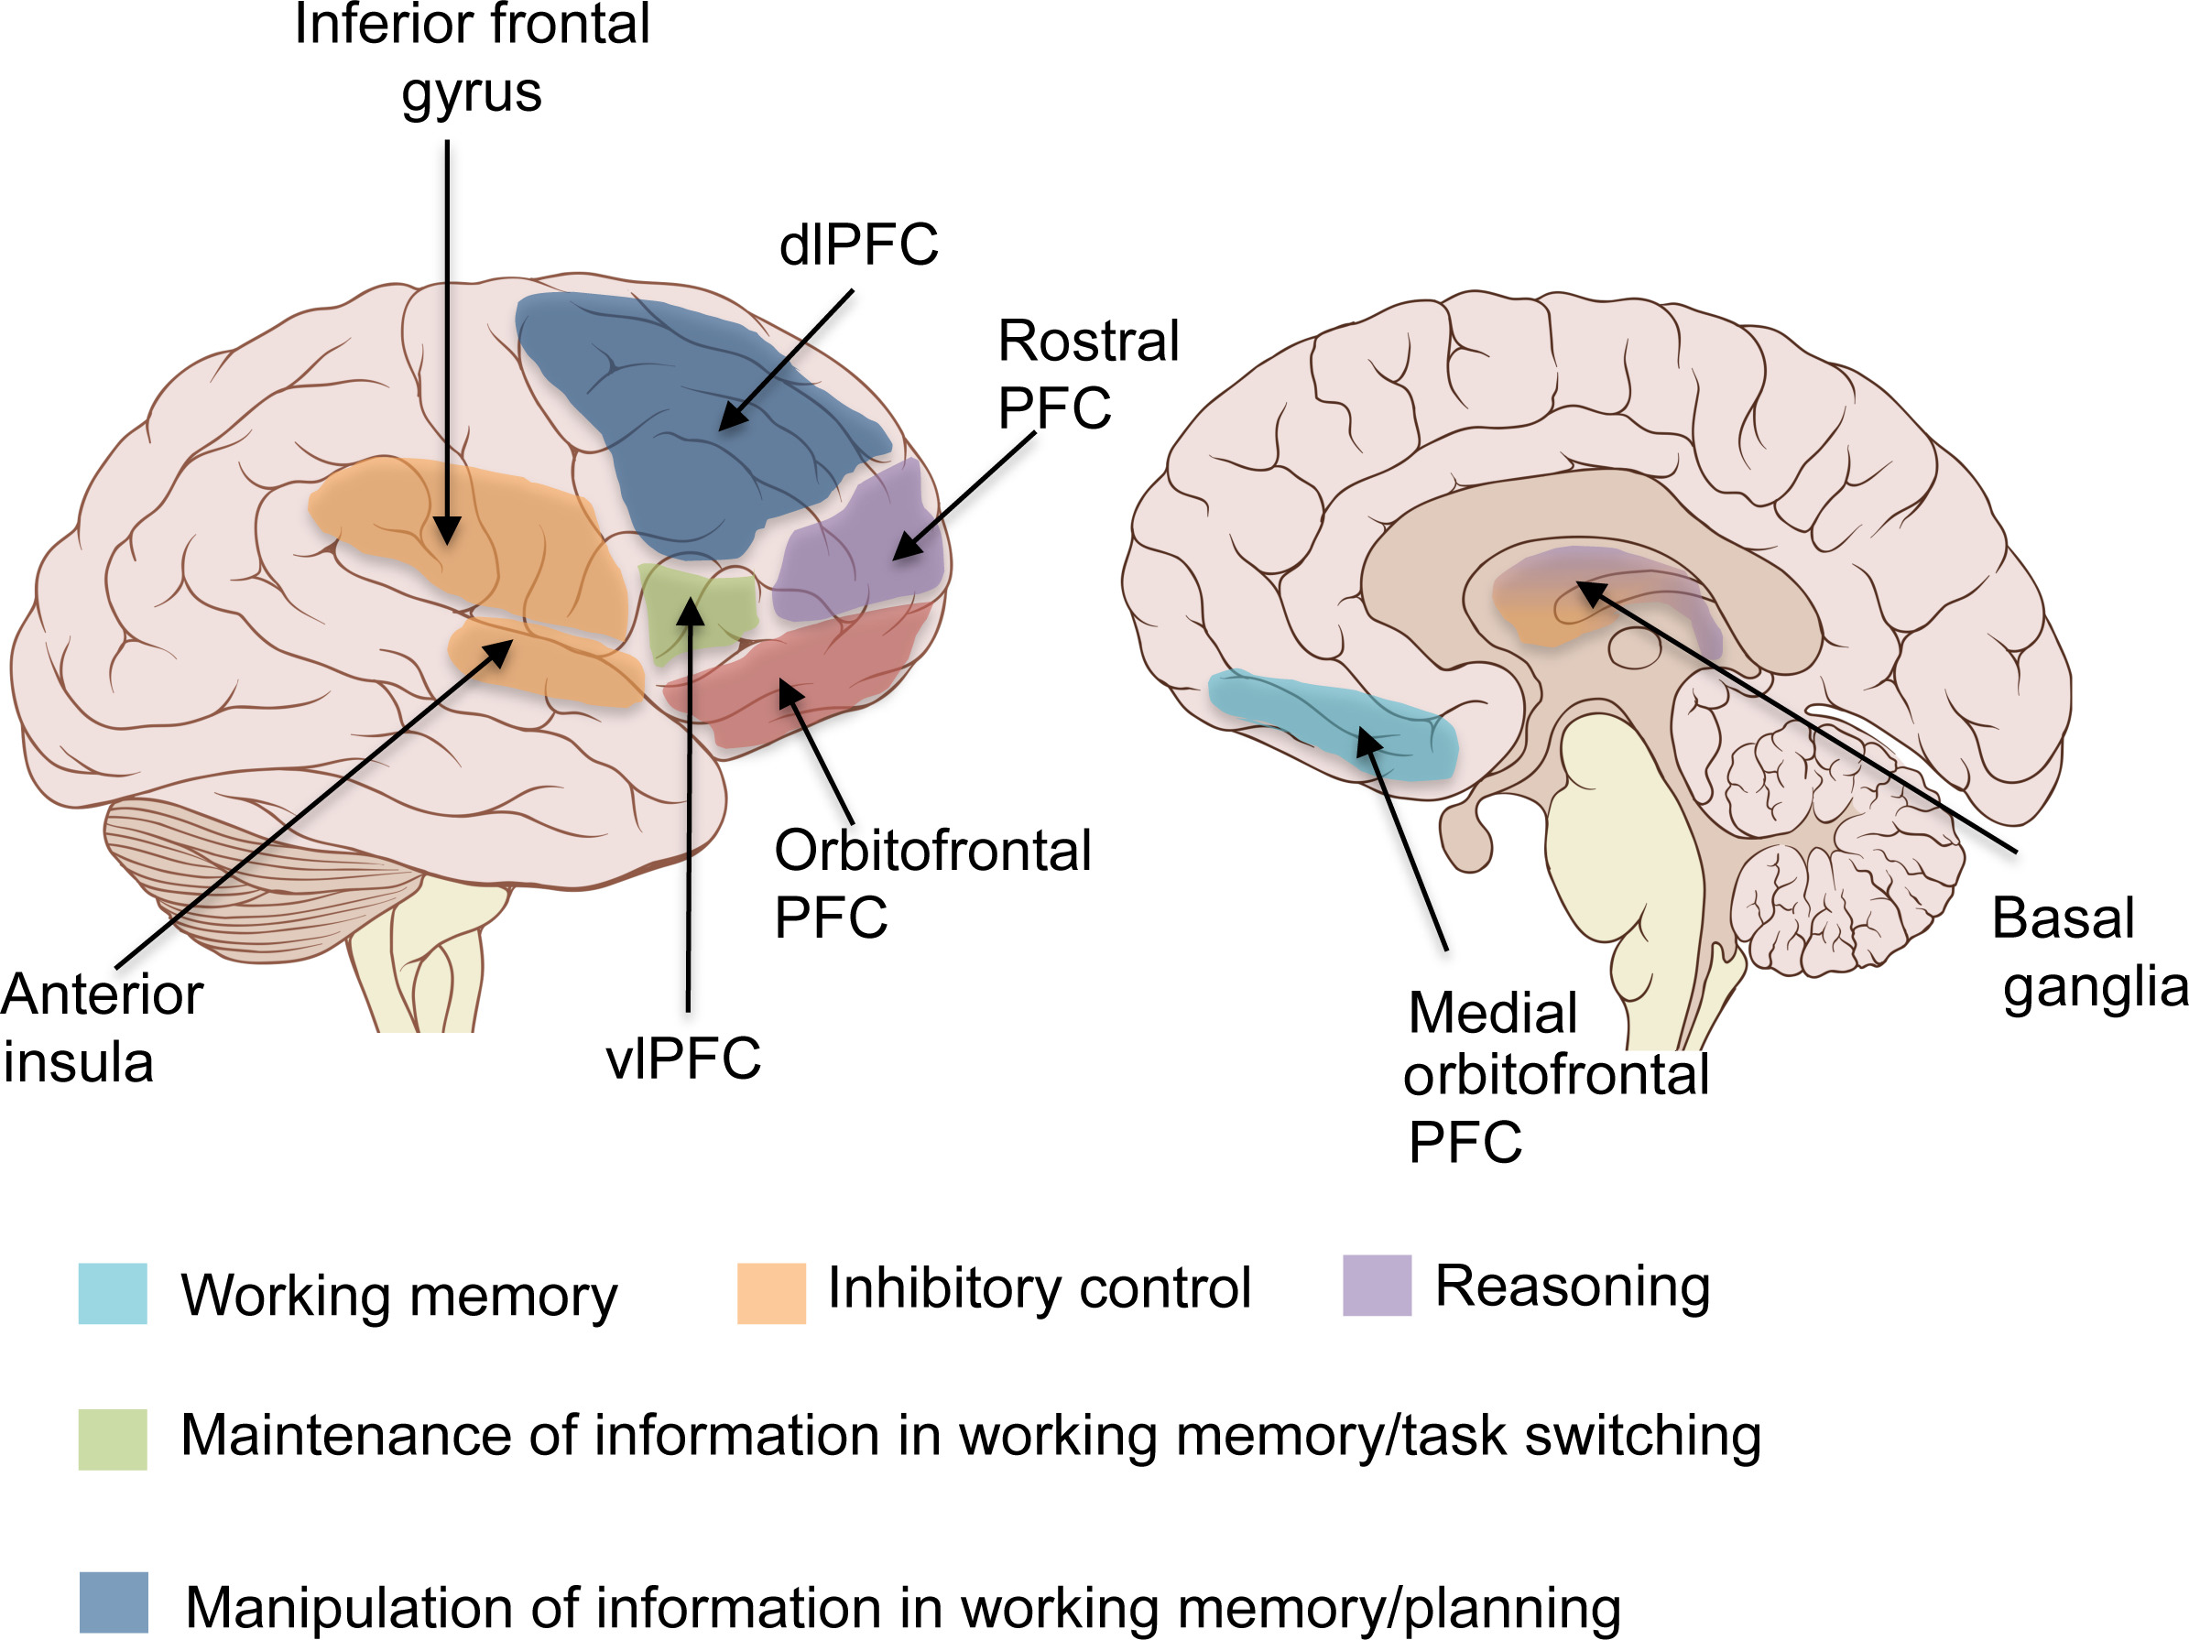
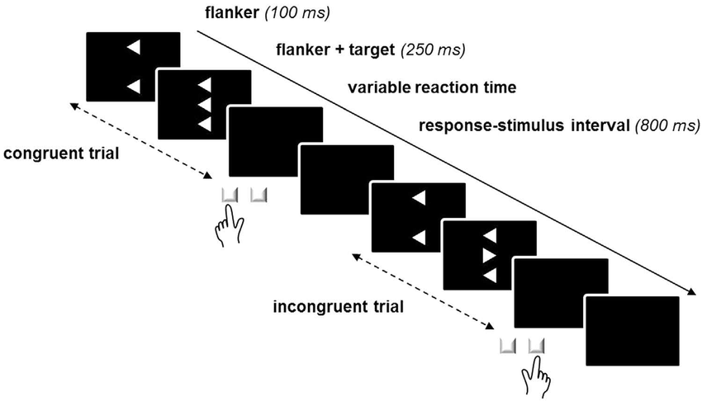
Cognitive Control Brain Network
Traditional Tests
Stroop task
Flanker task
Cristofori et al. (2019). Executive functions. Handbook of clinical neurology, 163, 197-219.
Notes:
Cristofori, I., Cohen-Zimerman, S., & Grafman, J. (2019). Executive functions. Handbook of clinical neurology, 163, 197-219.

Slide 6
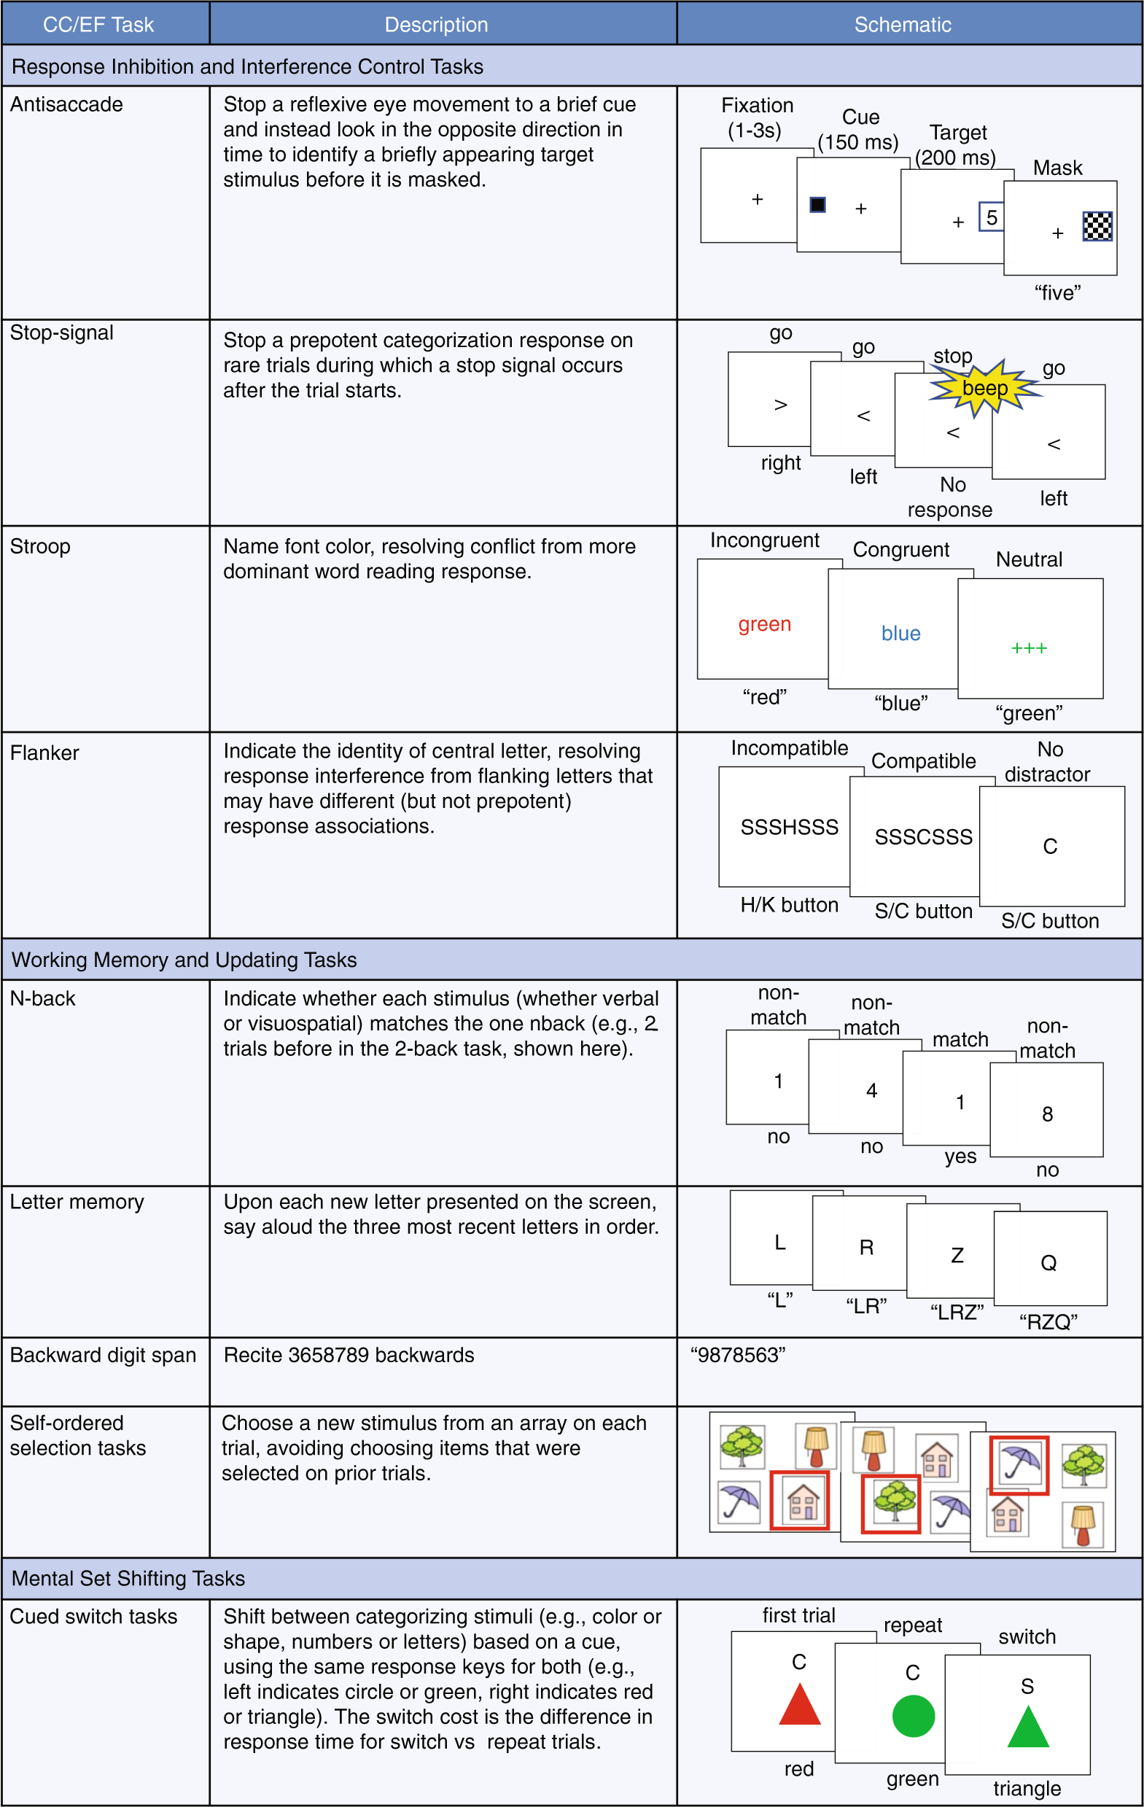
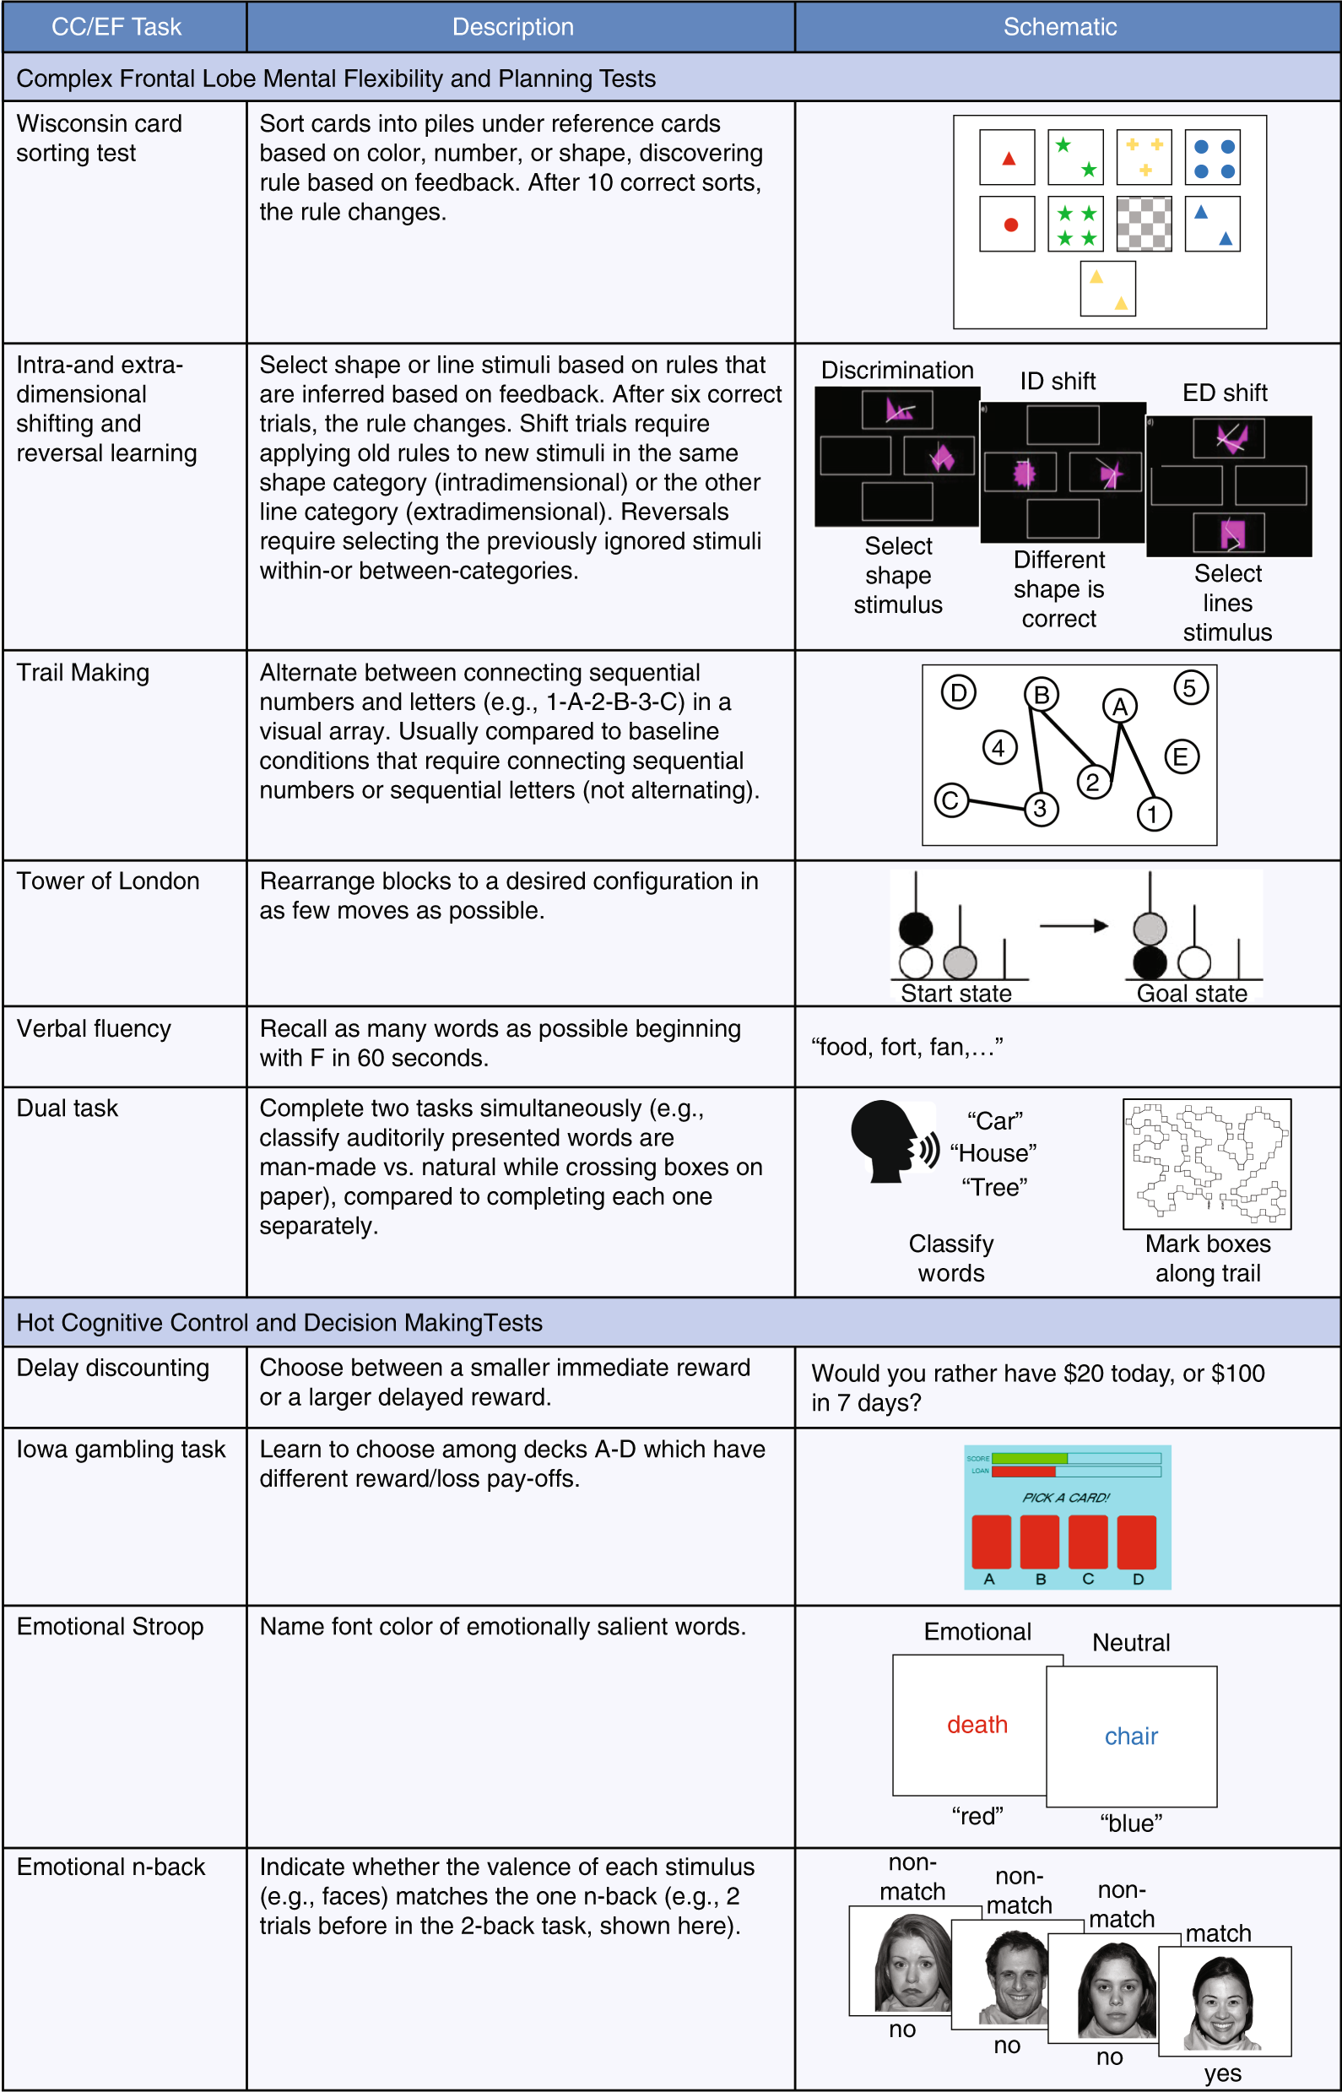
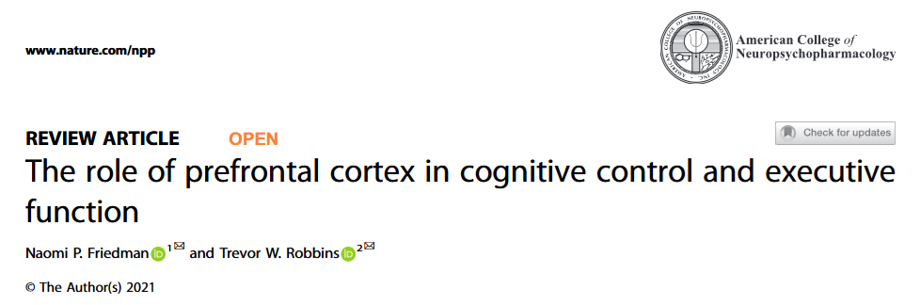
Existing Tasks

Slide 7
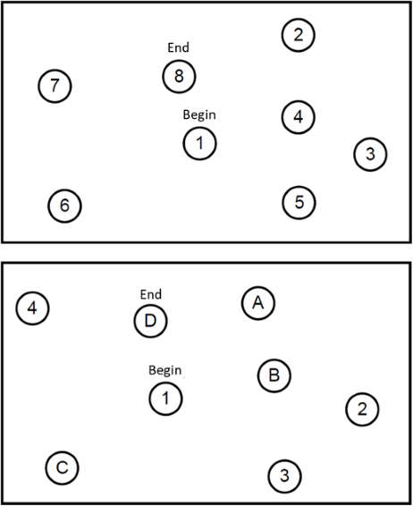
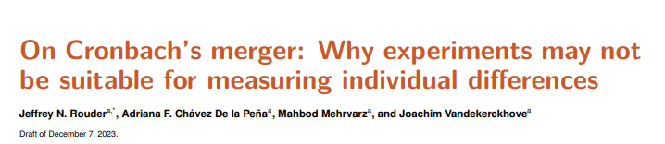
Substractive Paradigm (aka « Contrast Theory »)
Many neuropsychological tasks are based on the « substractive » paradigm in which we contrast 2 conditions (e.g., incongruent – congruent) to compute a score
Good but issues with reliability
Cronbach’s merger
TMT A
Processing Speed
Motor (speed + precision)
Visuospatial exploration
Strategy
Contextual
TMT B
Processing Speed
Motor (speed + precision)
Visuospatial exploration
Strategy
Contextual
+ Flexibility
TMT B – TMT A = Flexibility (in theory)
In reality, all of the contributing factors are sources of noise (add trial variability)
Large test-retest variability
In practice: (TMT B + noise) – (TMT 1 + noise) = Flexibility + noise x 2
This one of the main driver of the « reliability crisis » in neuropsychological measurement

Slide 8
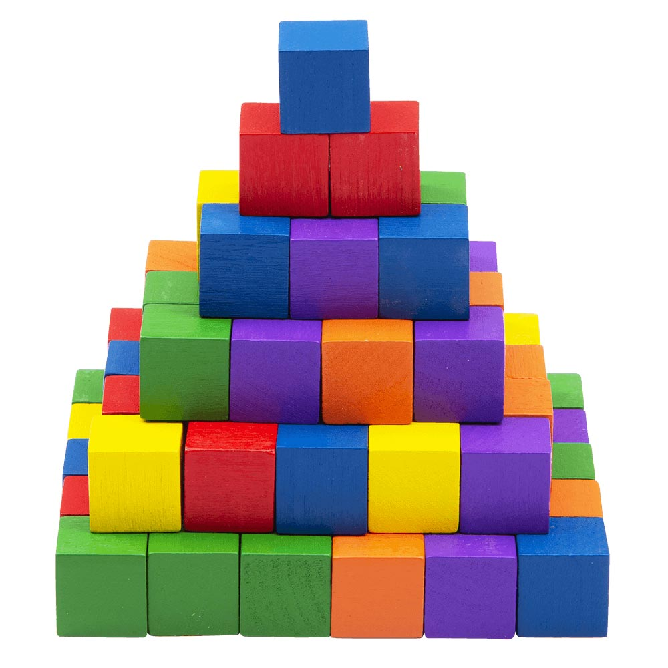
Additive Paradigm
Solution:
Consistent tasks
Systematically measure the baseline proficiency
Use the knowledge of other parts to contextualize scores and more reliably quantify performance (Bayesian priors)
Task D
Task C
Task C
Target condition
(e.g., « conflict » or « incongruent »)
Target mechanism + Random processes
+ Context?
Control condition
(e.g., « congruent »)
Random processes
+ Context?
Task B
Task B
Baseline Proficiency
Task A
Task A
Task A
Paradigm

Slide 9
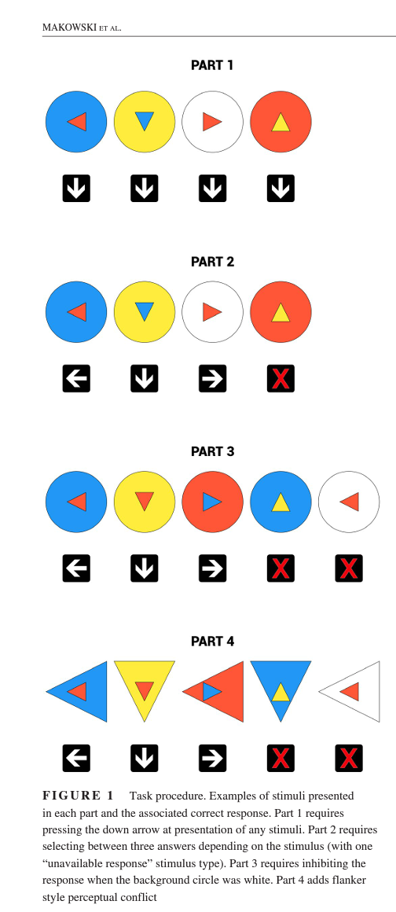
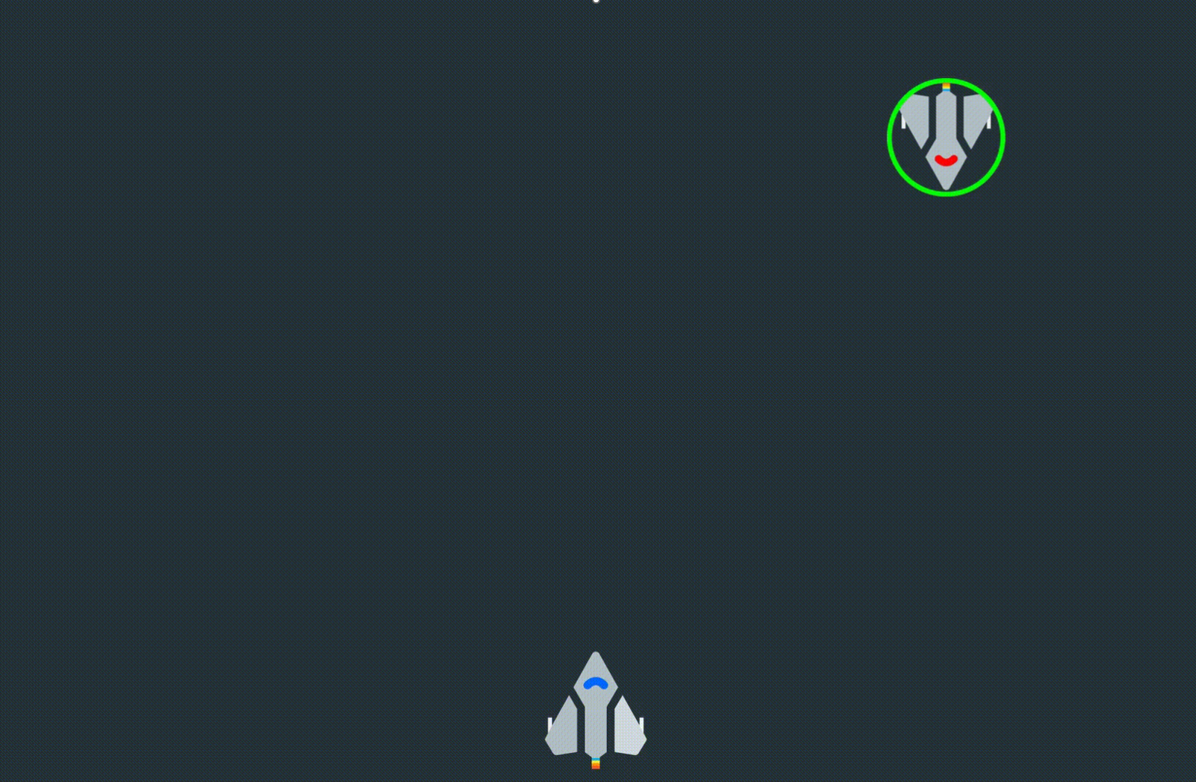


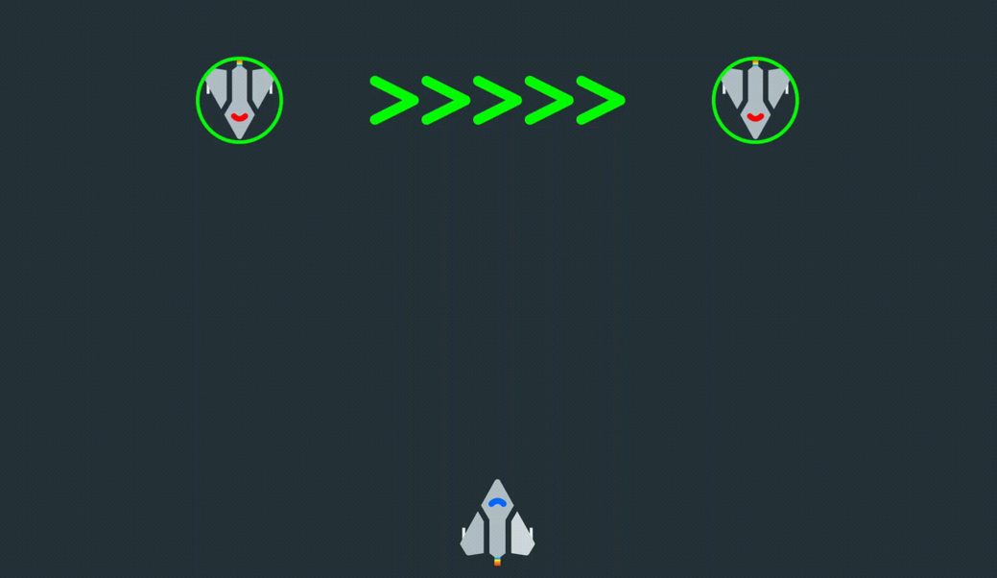
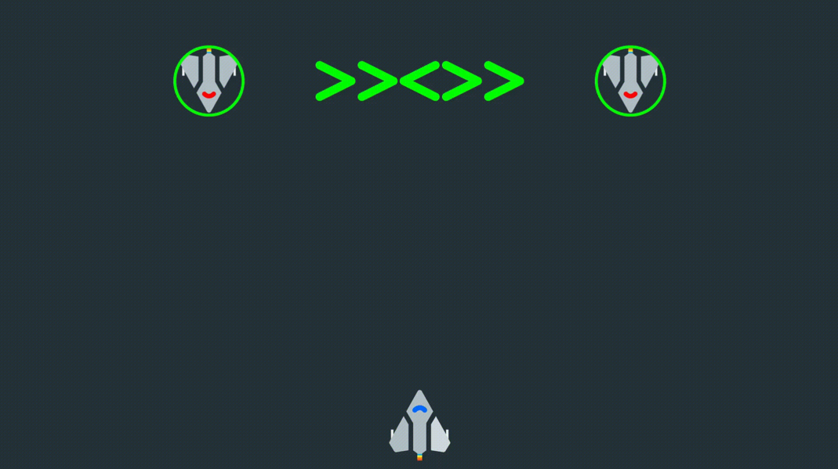
How?
Cognitive Control Task v1 (Cocon)
Sequential and additive decomposition mechanisms
Part 1: Processing Speed
Simple reaction time task
Part 2: Response Selection
Congruent response choice
Part 3: Response Inhibition
Go/No Go Paradigm
Part 4: Conflict Resolution
« Flanker » Paradigm
Issues
Amount of trials
Not engaging
Cognitive Control Task v2 (Star Control)
Narrative Context
Phase 1: Processing Speed
Phase 2: Response Selection
Phase 3: Stop Signal Task
Phase 4: Flanker
Issues
Static
Not online

Slide 10
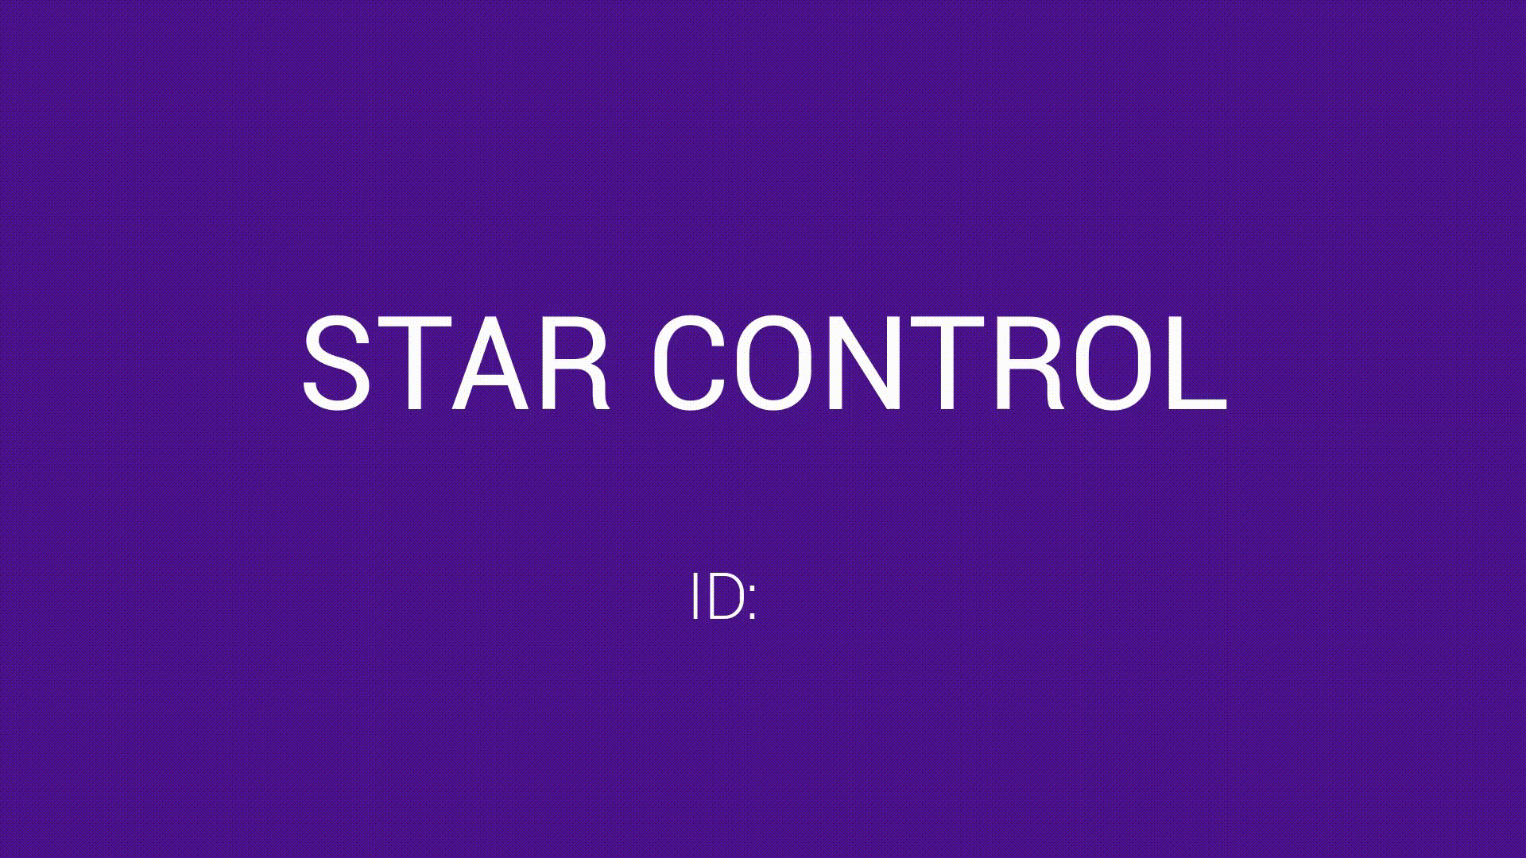

Slide 11
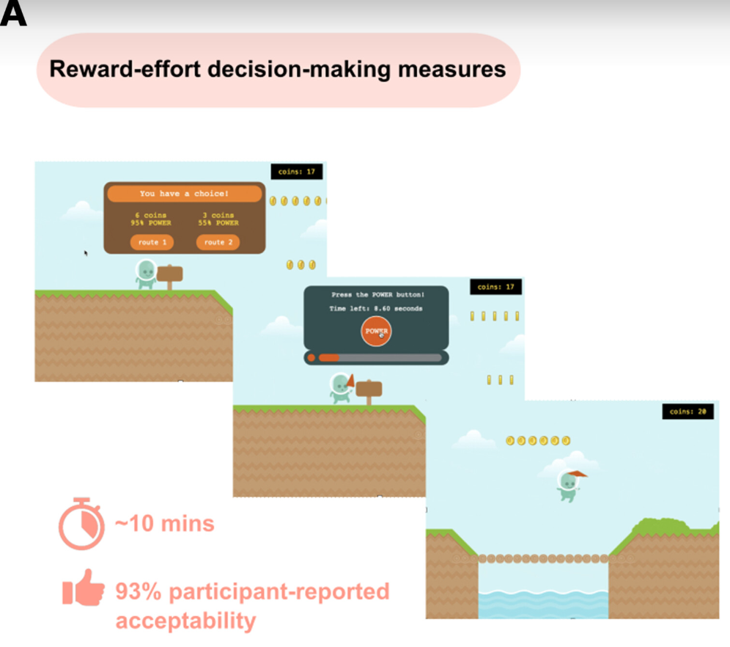
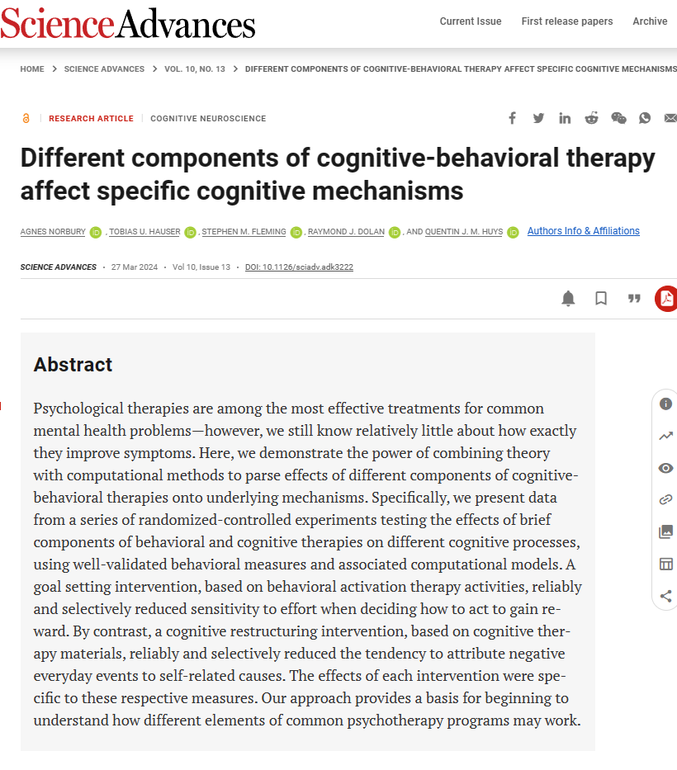
Gamification
Gamification != pretty graphics
Graphics does not predict sense of presence
Gamification = mechanisms that make it enjoyable and addictive
Pleasure and reward: dopaminergic system
Examples:
Scores & Competition
Reactivity: consequences to action
Sense of Progression (levels, stages)
Presence & Escapism
…
Examples
https://github.com/agnesnorbury/cognitive-mechanisms-psychotherapy?tab=readme-ov-file
MindPulse
https://www.frontiersin.org/journals/neuroscience/articles/10.3389/fnins.2021.650219/full
https://www.tandfonline.com/doi/full/10.1080/23279095.2024.2307413

Slide 12
1. The Game

Slide 14
Doggo / Nogo
Story
The story of a good boi named « Doggo » and a cat named « Nogo »
(A play on words on the « Go/No-go » paradigm for inhibition)
Specifications
Suited and compelling for wide range of ages, conditions and demographics
Extendable design suited for a unified framework for evaluating various aspects of CC
Online
Free, and open and reusable (easy integration in other experiments)
Engaging enough for self-engagement (big data?)
« Real » game (score, levels, scoreboard, …)
« diagetic » game design
Challenges
Art and Animations
Backend (Data collection, storage, re-playability)

Slide 15
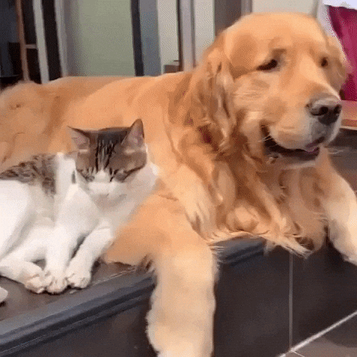
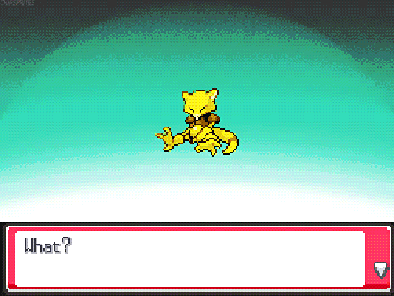
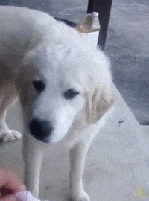




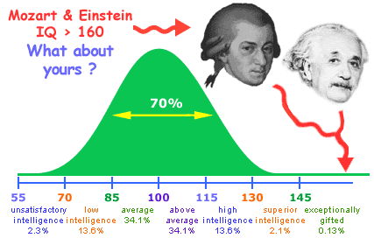
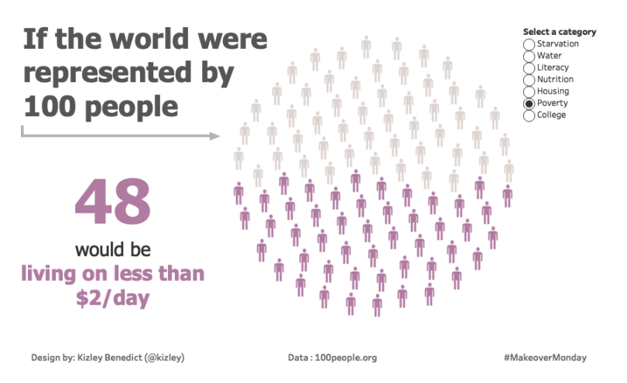
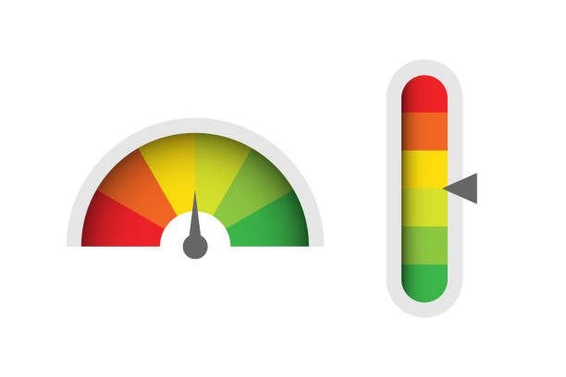
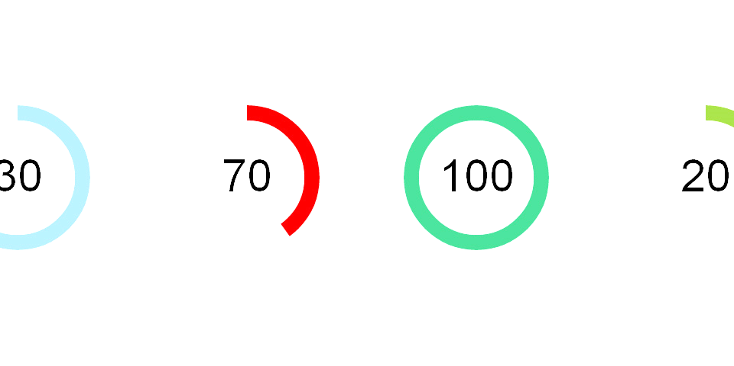
Game mechanisms
What does “gamified” mean?
Gamified != pretty graphics
Gamified = game mechanisms
Narrative engagement
Compelling story that generates engagement and interest
Response Feedback
Each trial is rewarded / punished with multimodal cues
Score system
Competitive aspect
“Leaderboard”: feedback on performance compared to others
Creates challenge and “challenge your friend” opportunities
Sense of progression
“Evolutions”
Levels: each level targets specific cognitive mechanisms
Let’s start step by step with “LEVEL 1”: simple reaction time

Slide 16

Proof of concept
Level 1: Simple Reaction Time Task
« Simple »
Only one response choice (no decision making process)
No « errors » possible
Procedure
Variable ISI (no stimulus)
Stimulus appears
Wait until response and record RT
Penalize « slow » responses (e.g., sausage gets rotten and doggo doesn’t like it)
457
457
457

Slide 17
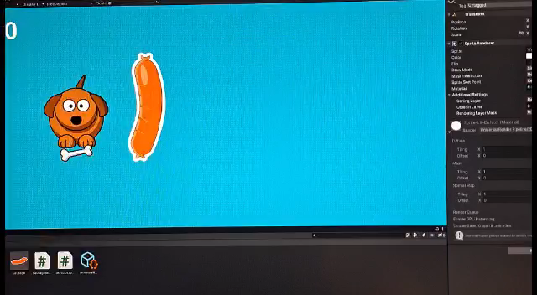

Slide 18
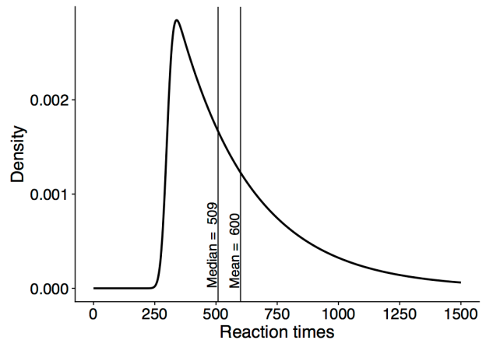
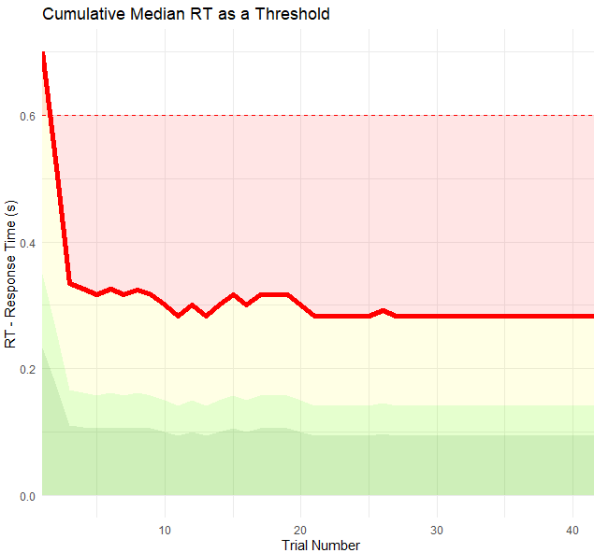
The need for « bad » trials
Need to differentiate between « early », « fast » and « slow » trials
How to set a threshold?
Based on norms? E.g., stratified by age?
Adaptive threshold
Cumulative Median RT
If RT > Threshold = « Slow » trial: Negative feedback
If RT <= Threshold = « Fast » trial: Positive feedback
Predictible behaviour: ≈ ½ trials are « fast » (by definition)
Using an adaptive threshold creates the opportunity for another « gamification mechanism » where people implicitly play against themselves
Potential issue: erratic threshold that would create confusion for players
Stable Index with quick convergence (stabilizes after ~10 trials)

Slide 19
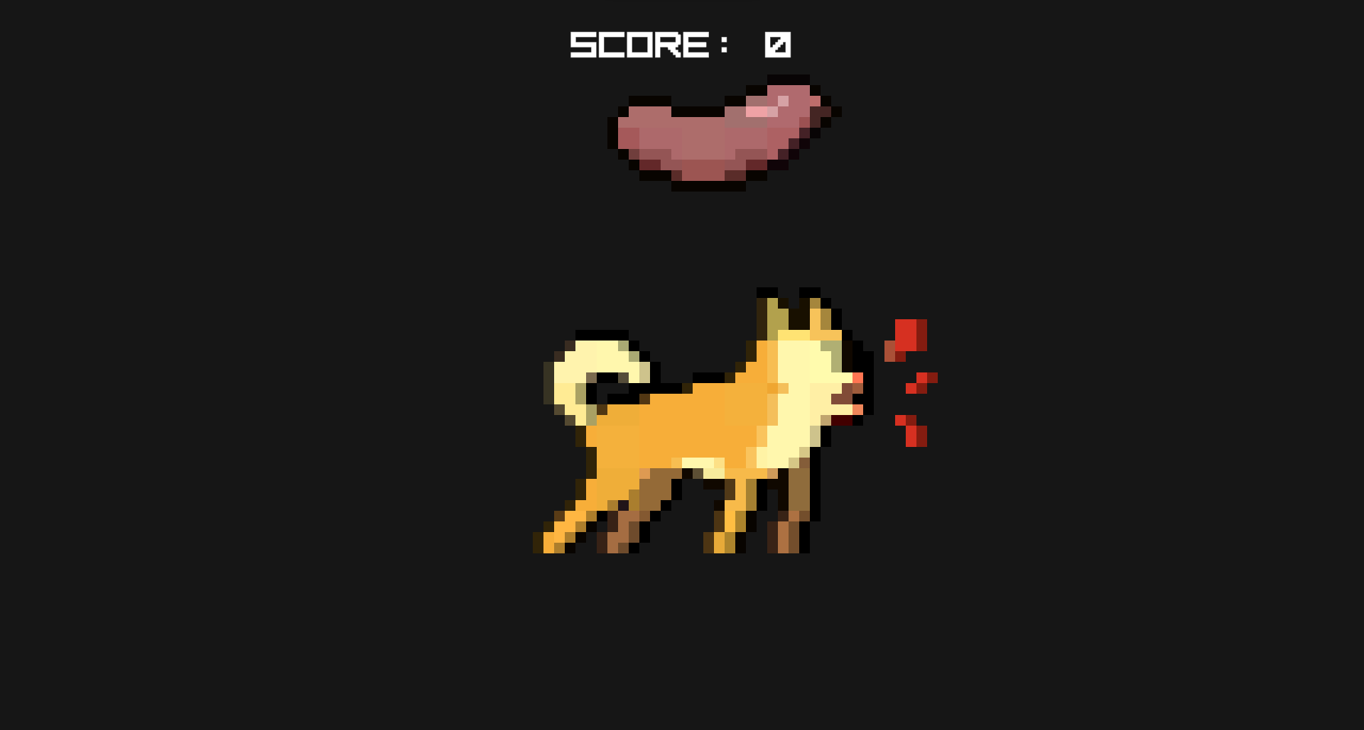

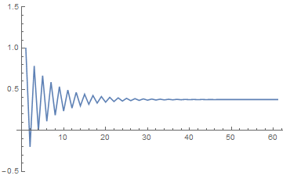
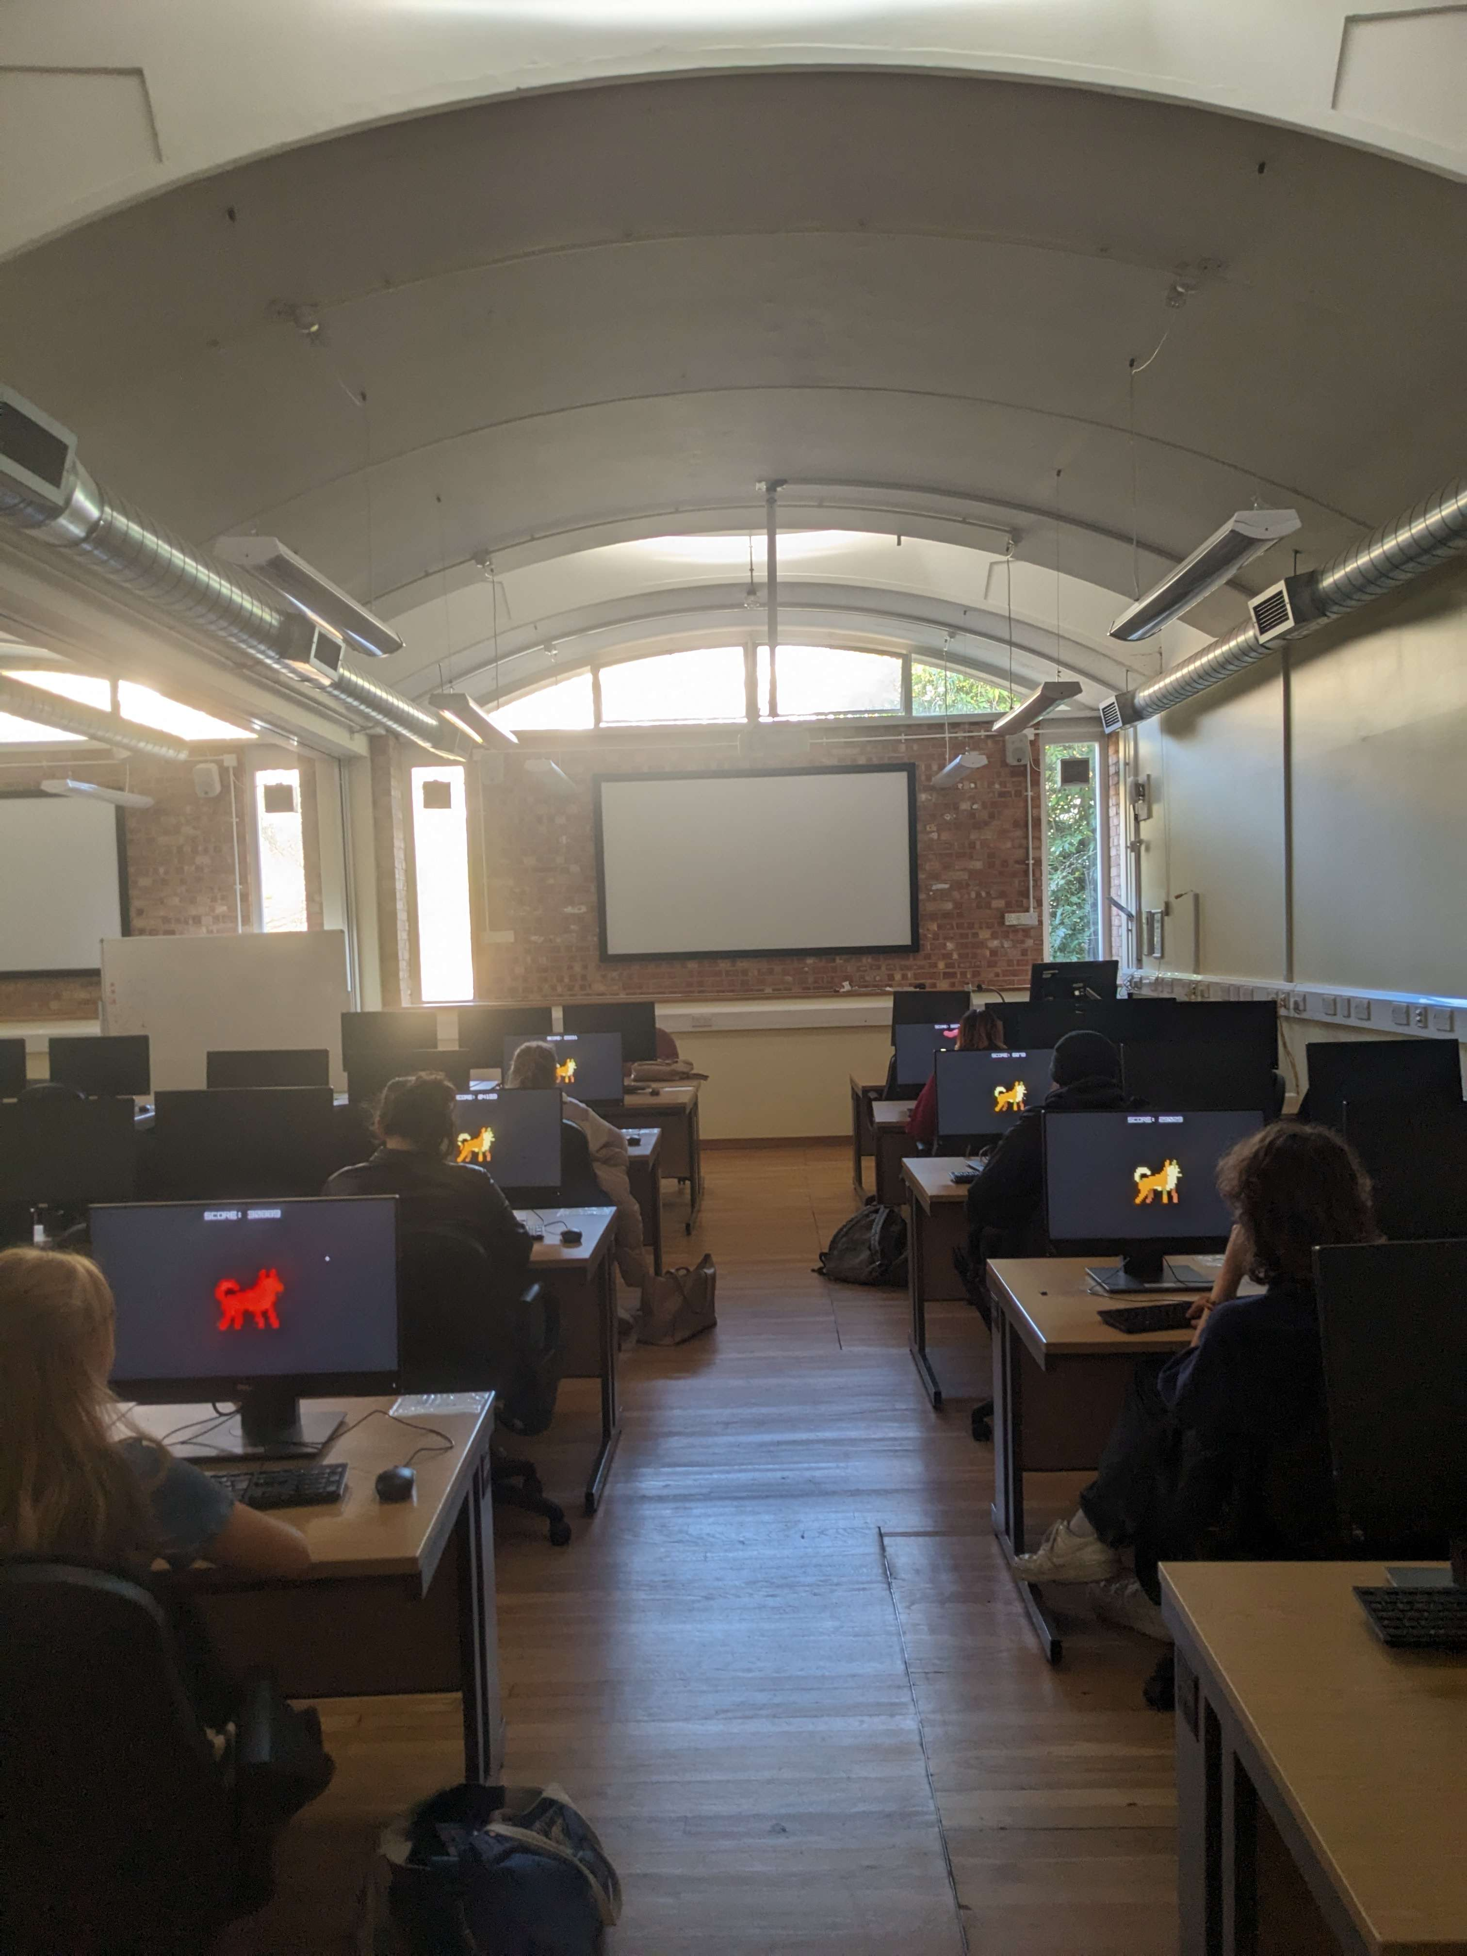

Pilot Study
Aims
Implement a prototype of the game
Get a sense of the number of trials
After how many trials do indices (e.g., “average RT”) become stable
Get a sense of optimal ISI
What is the ISI window that maximizes participant’s performance
Auz Moore (3rd year dissertation)
Implemented a prototype from scratch in Unity
25 participants (age = 24.3 ± 6.5) played Doggo/Dogo
120 Trials
Random ISI [0.2-3.5 seconds]
Test-Retest
+
Stimulus
+
RT
RT
Stimulus
ISI
ISI

Slide 20
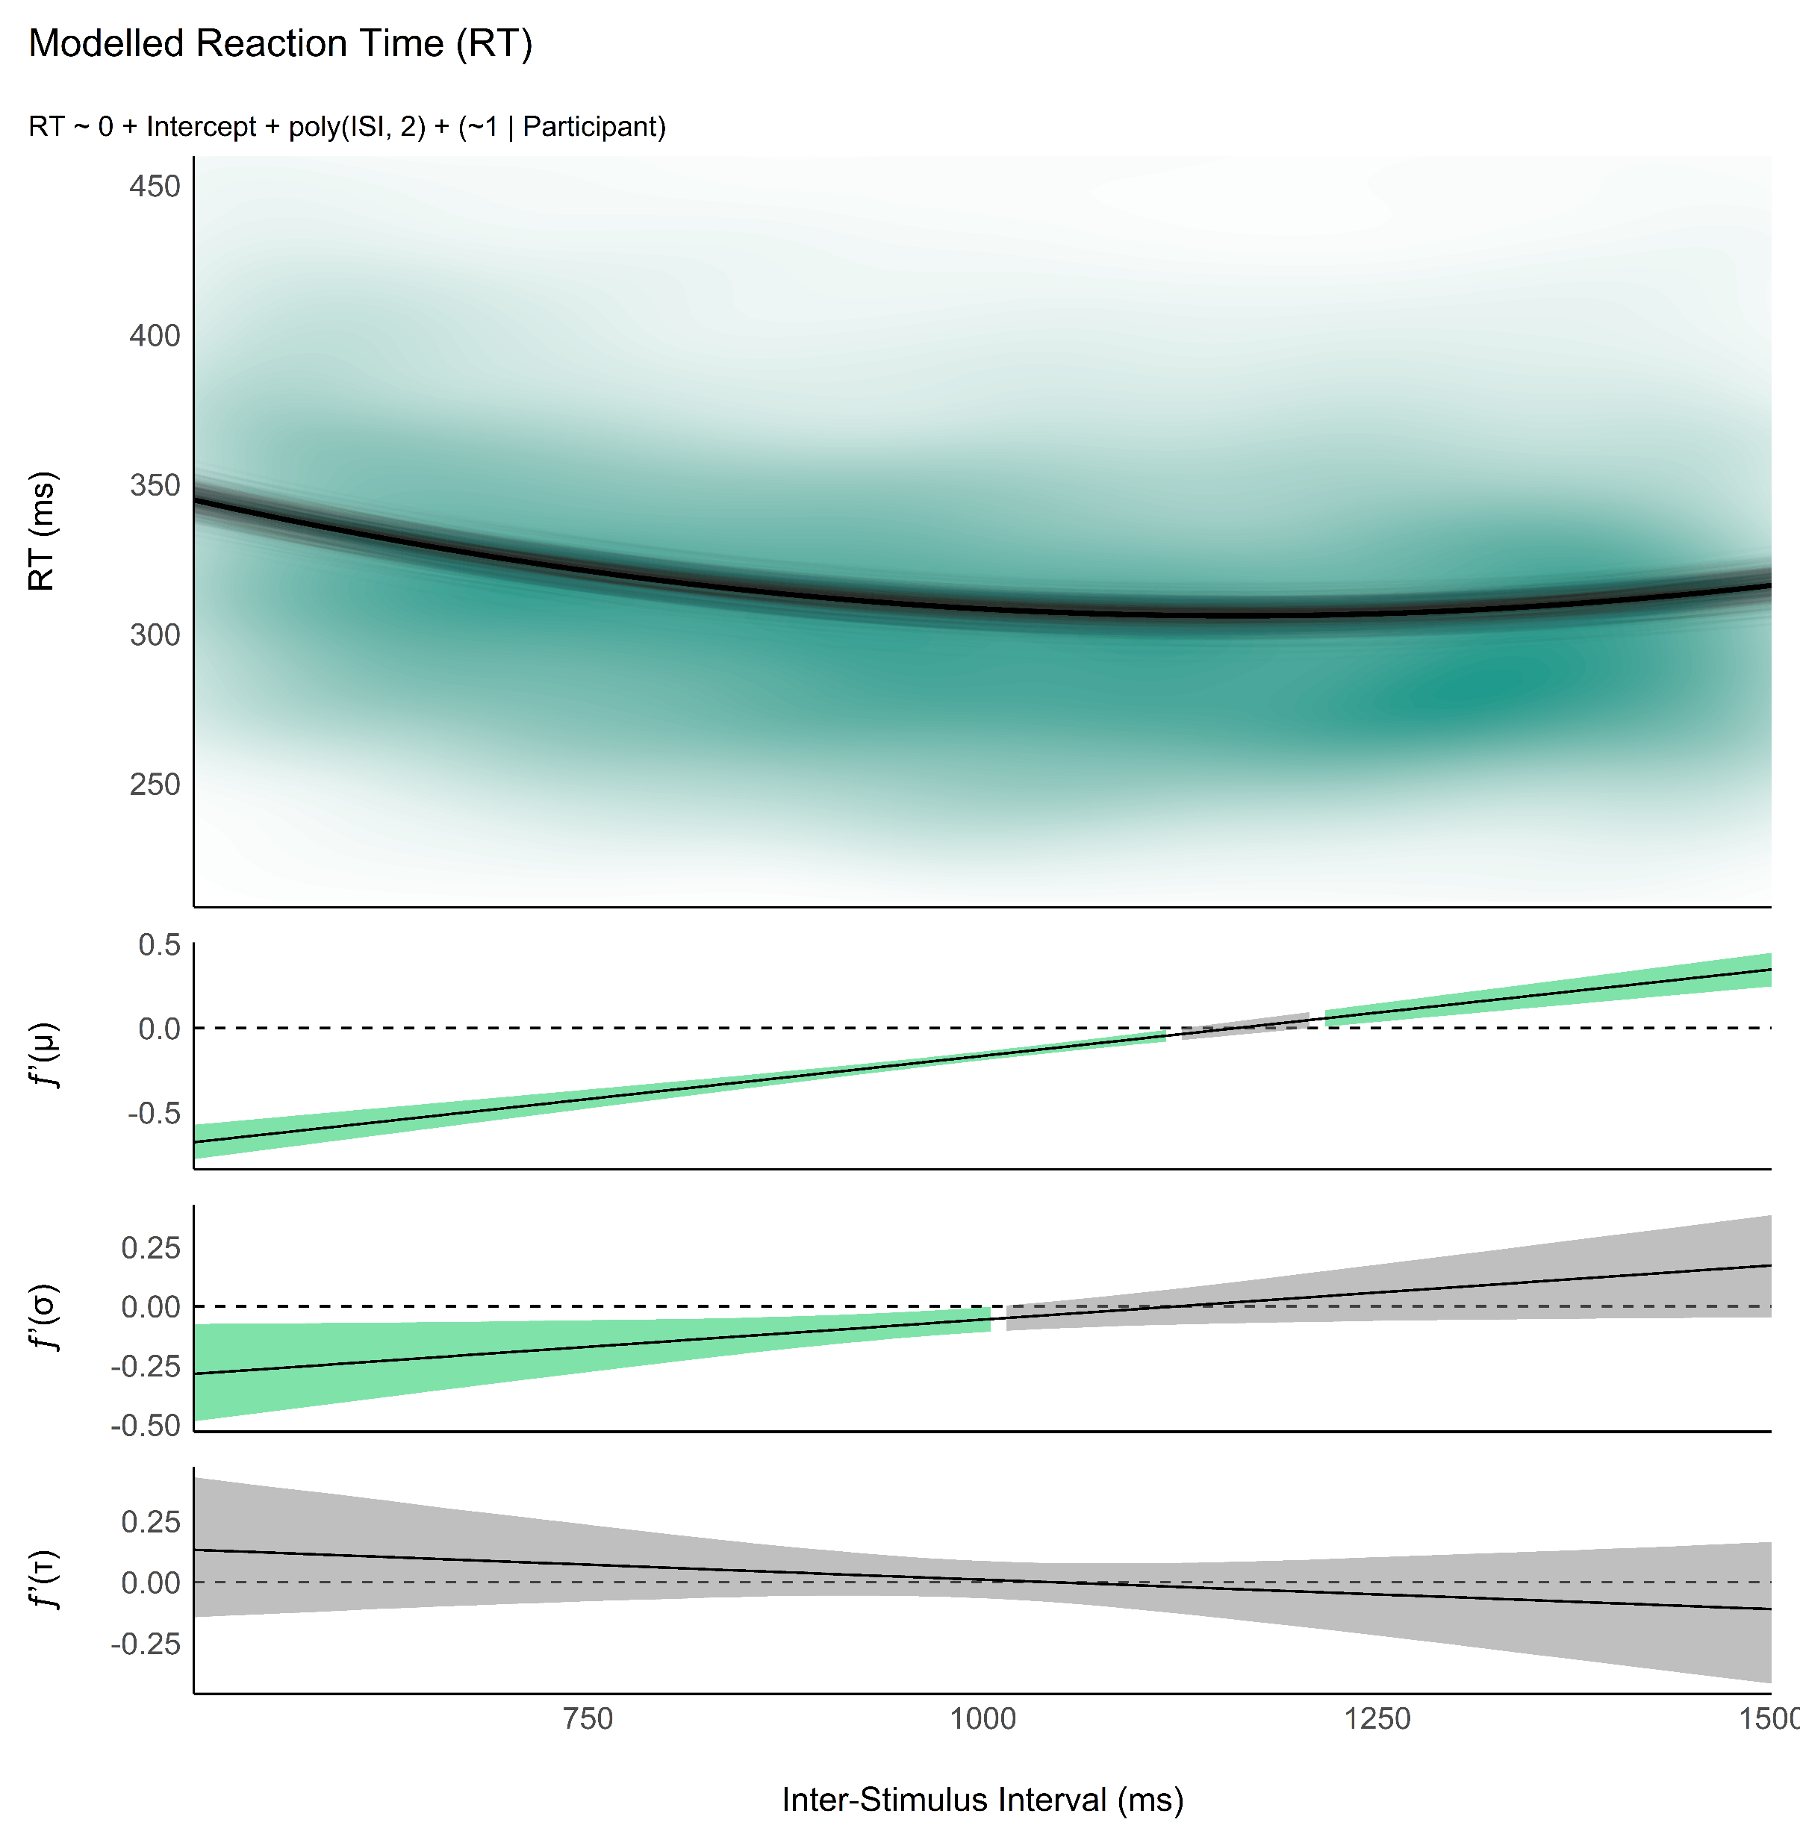
Pilot: Development of the Optimal Simple RT Task
Reliability - How many trials?
Run experiment with high number of trials
Analyze convergence of estimates
Analysis
Optimal model: LBA? Wald? LNR? DDM?
Ancillary project
Optimal priors for individual SSMs from group-level
Effect of ISI
Important that participant are in optimal conditions when doing an RT task to be as fast as they can
Variable ISI is important to prevent planned / rythmic responding
But short / large ISI can impact RT characteristics (+ differently for different people)
What is the optimal ISI window?
Measure minimum of U effect in each participant
Define the best ISI range (95%) to capture that minimum

Slide 21
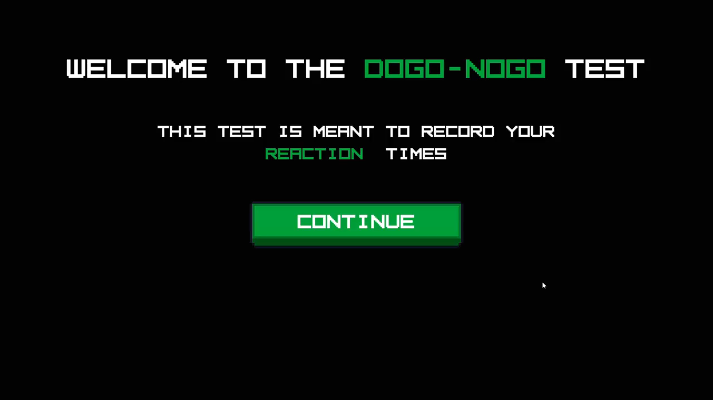

Slide 22
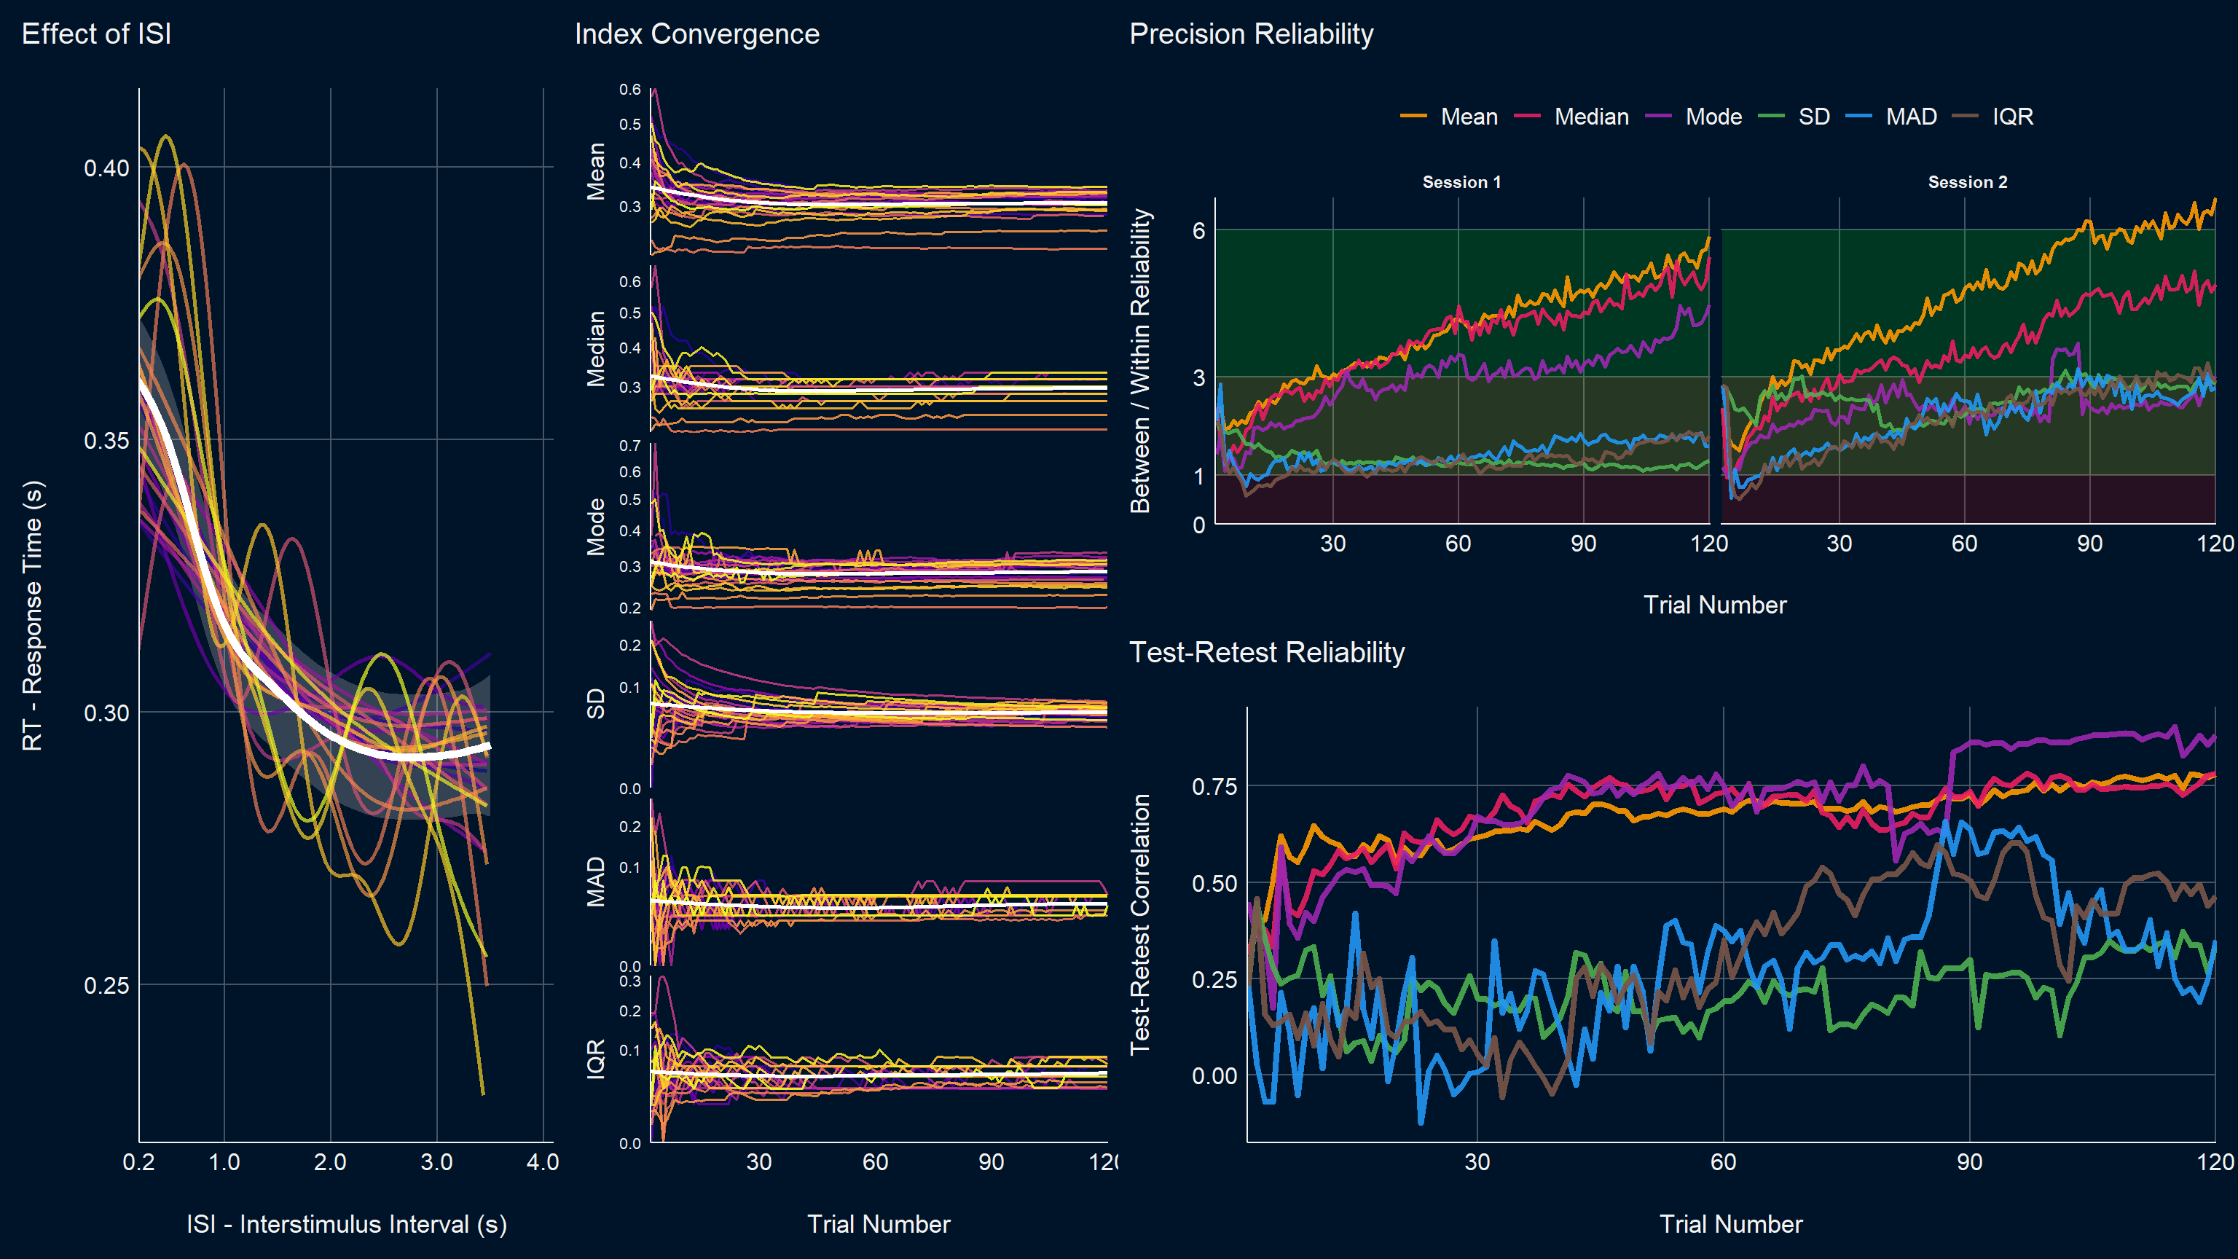
Results
Notes:
Indices:
- Aristodemou, M. E., Rommelse, N., & Kievit, R. (2024). Attentiveness modulates reaction-time variability: findings from a population-based sample of 1032 children. Collabra: Psychology, 10(1), 122517.

Slide 23
Towards v0.1

Slide 24

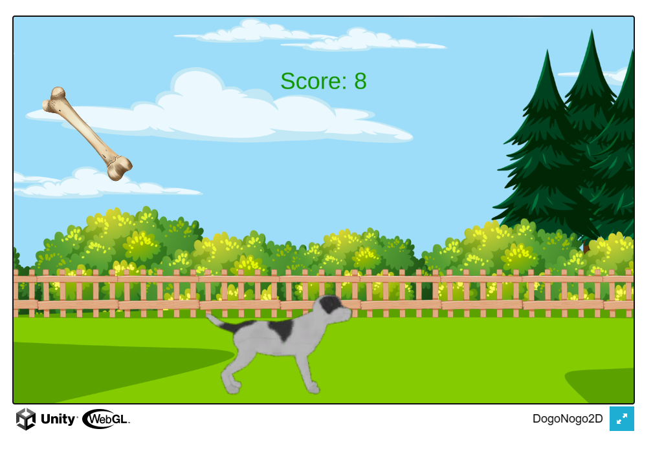
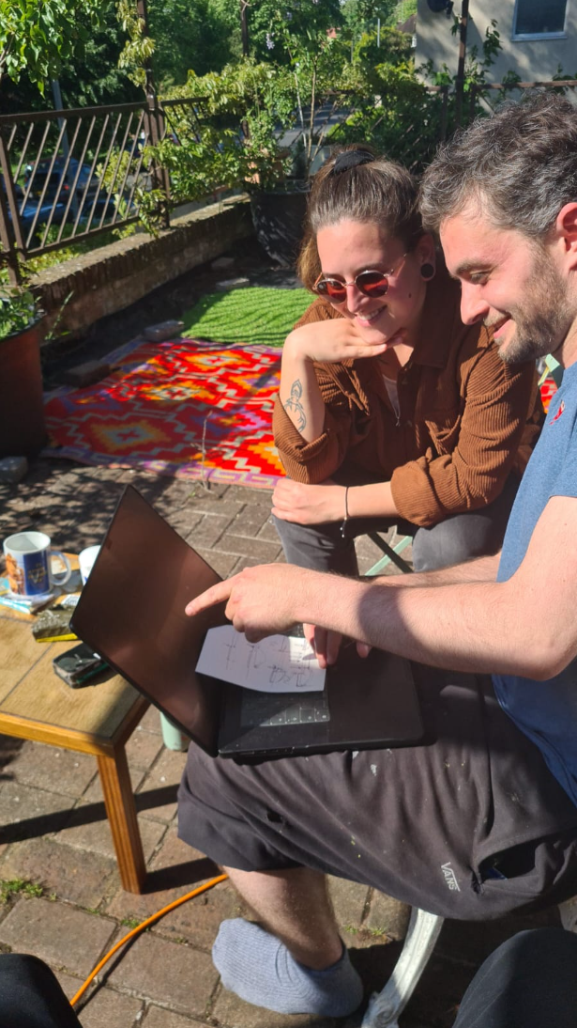
The Creation of V0.1
Sussex Psychology Software Team
Notes:
Less barebones but the aesthetic improvement was debatable

Slide 25
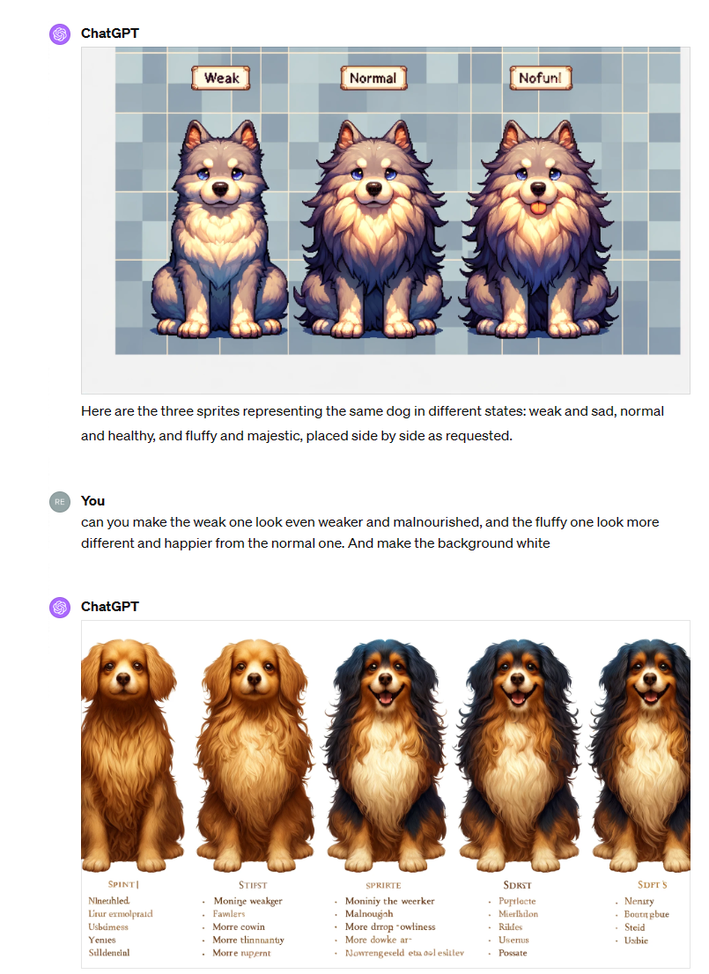
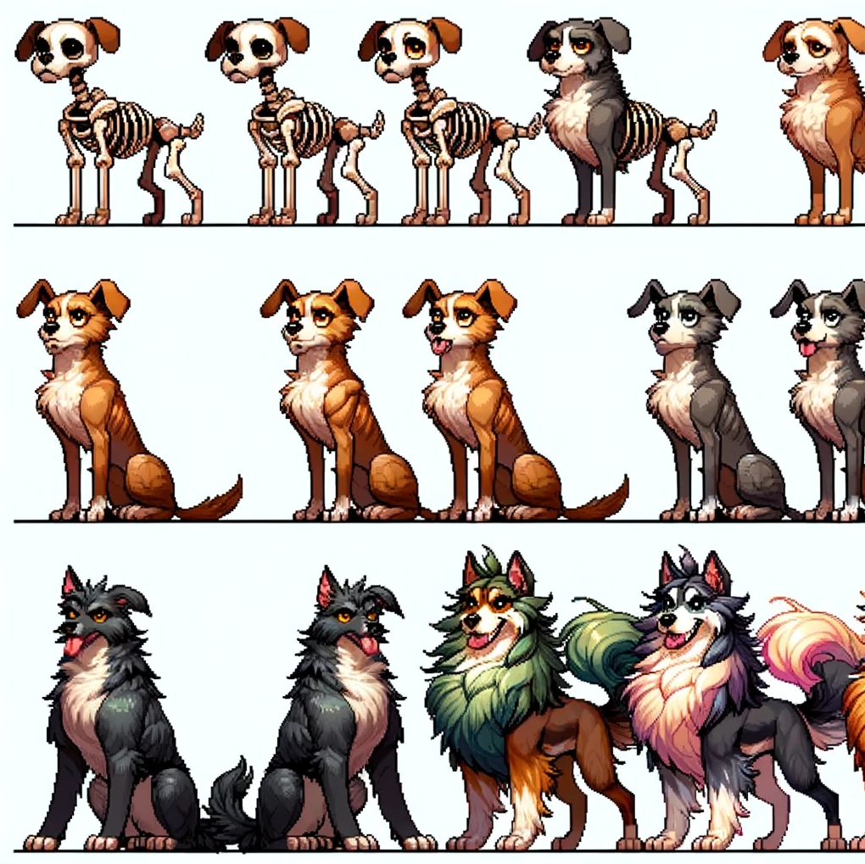
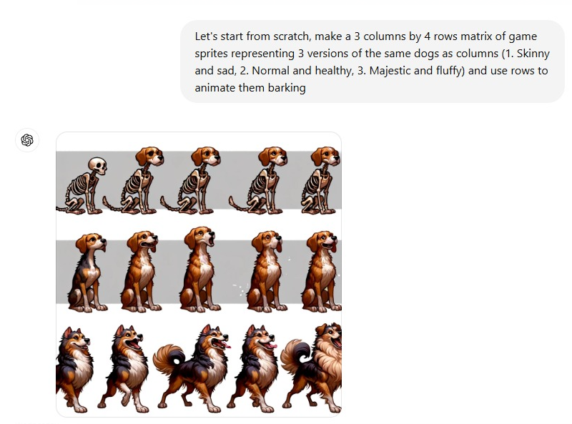
Art Problem
Tests with AI
Moving forward: collaboration with artists?
CALL FOR TALENTS

Slide 26
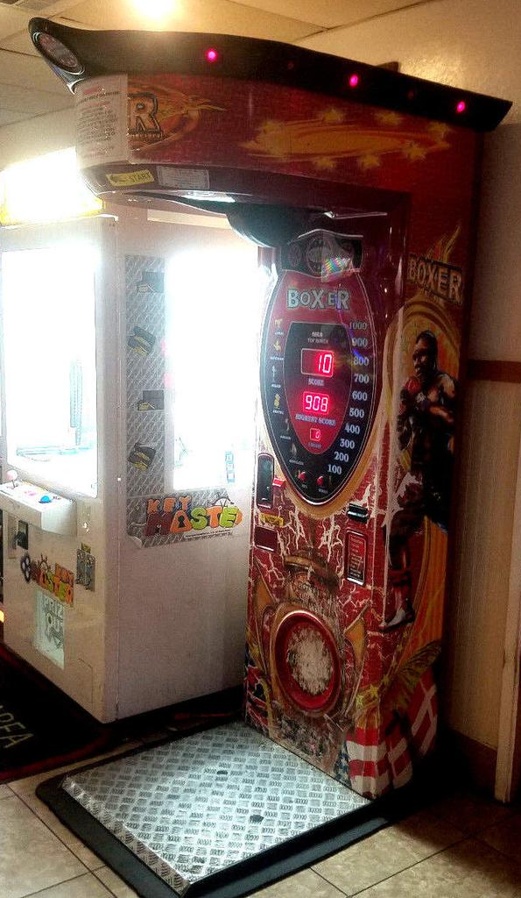
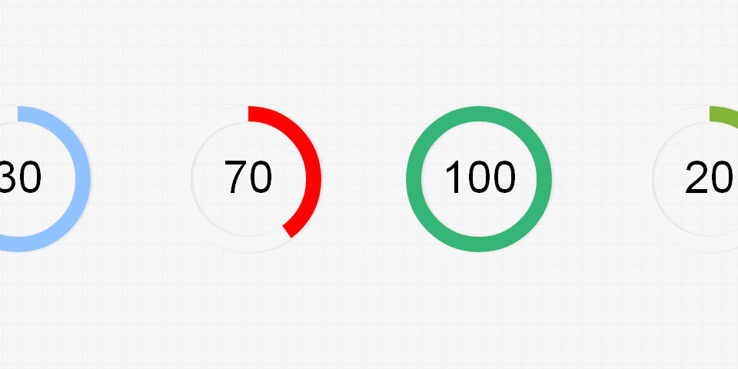
Level 1: Simple Reaction Time
457
3 blocks
The dog sprite « evolves » between each: Rewarding aspect
From malnourished skinny dog to majestic shiny one
Animation
« Warf » when button is pressed fast enough (e.g., < average) with dog smiling (Positive feedback)
Groan if slow answer with dog being like « :S »
Stimuli gets « bad » over time (speed of animation depends on the distribution of participant’s RTs, e.g., 95% ETI, or 2*average)
Score gets updated with a color gradient that depends on the speed (same underlying variable controls the color of the score update and the aspect of the stimulus)
End scree
Score (IES) increases alongside a bar that gets filled up following the percentile score
457
457

Slide 27
Menus
Start screen
Start a New Game
E-mail address
Age
Gender
Already played?
E-mail address
Continue
Start a New Game
Read Terms & Conditions
Need for a mention « by playing, I accept the terms & conditions »
About
Description, contact, etc.

Slide 28
Score and End Screen
Marketing
Test your brain
Train your brain*
Fluid intelligence is a key symptom of many psychiatric disorders… preserve it
Cognitive training / rehabilitation is a validated procedure used in neuropsychology
General final score (« leaderboard »)
Score number + chart
Relative to the population: auto-updated from the database?
+ score by levels?
If score too low, do not display comparison chart, but instead tips on how to do better?
Replay button
Can jump to specific level
Provides a code that can be copied (to be used in other studies, e.g., prolific & lab-studies)

Slide 29
Score
Score starts at 0
If « Positive » trial (RT <= Threshold), score increases
+ log(1 + |Threshold – RT|)
If « Negative » trial (RT <= Threshold), score decreases
- log(1 + | Threshold – RT|)
Score udpate is multiplied by RT so slow RT are penalized (regardless of the difference)
Have a maximum treshold (~600 ms?) to avoid cheating
Early responses are penalized (- score) and lead to a restart of the ISI
Character evolution
Depending on score
Shiny dog 1: score [100, 1000]
Default dog: score [-100, 100]
Malnourished dog: score [-1000, -100]
When new range is reached, make « evolution » screen

Slide 30
Feedback
Score
Sound
Jump

Slide 31
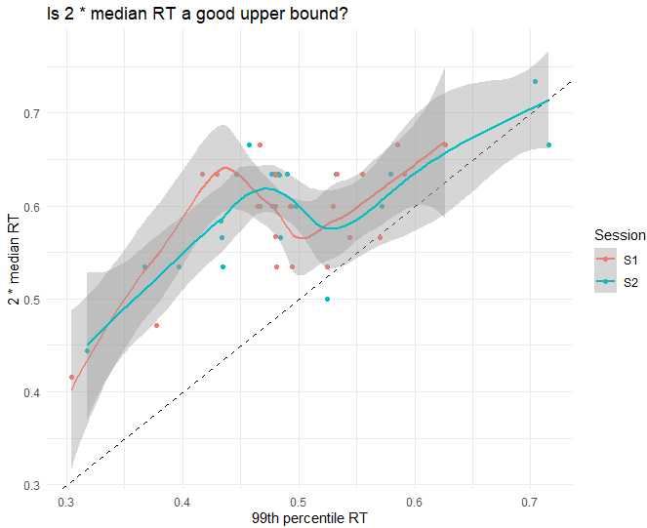
Score Computation
Dynamic values
Threshold (median RT)
RT_max = 2*threshold
Parameters (to be set)
Score range: [score_min, score_max]
RT bounds: [RT_min, RT_max]
Trial score calculation
Early trial (during ISI): -score_min
Slow trial (RT > Threshold): +0
Fast trial (RT <= Threshold): +Score
1. Normalize RT relative to the RT bounds
N_RT = (RT – RT_min) / (RT_max - RT_ min)
Gives a value between 0-1
2. Reverse the normalized RT (higher values better)
N_RT = 1 – N_RT
3. Convert to score
Score = score_min + N_RT*(score_max – score_min)
Example
Score range: [100, 200]
RT bounds: [200, 600]
Trial’s RT = 470 <= threshold
Fast trial! Score computation
N_RT = (470-200)/(600-200) = 0.675
Reverse: N_RT = 1-0.675 = 0.325
Score: 100 + 0.325 * (200-100) = 100 + 32.5 = +132.5

Slide 32
Dynamic Adjustment of Trial Number
Important: There must be a minimum number of trial per level
Minimum score per level = Minimum_trials/2 * score_min
e.g., 10 min trials = 10/2 = 5 * 100 = 500 score minimum per level
After each require required score computation, if required score < min. score, then min. score
Parameters
N_trials = 60
Score range: [score_min, score_max]
Minimum_trials = 10
The number of trials gets adjusted by changing the score required to complete each of the three level
Score for first level
N_trials1 = N_trials /3 = 20 trials (we would like ~20 trials on the first level)
N_trials1 = 20/2 = 10 fast trials (as by definition ½ trial should be < threshold)
1st level score: N_trials1 * score_min = 10*100= 1000
Participants play the first level…
Recompute the number of trials for the 2 remaining levels
Imagine that they are very efficient and often hit below threshold, earning more points and thus complete the level after 12 trials
N_trials = 60 – 12 = 58 trials
2. Score for second level
N_trials2 = N_trials / 2 (only 2 levels left) / 2 (in fast trials)= 58 / 2 /2
N_trials2 = 14.5 fast trials
2nd level score = 14.5 *100 = 1450
Participants play the second level… they are slow and complete after 35 trials
N_trials = 60 – (12+35) = 13 trials
3. Score for third level
N_trials3 = N_trials / 1 (only one levels left) / 2 (in fast trials) = 6.5
3rd level score = 6.5 * 100 = 650
1000
1000
1450
1000
1450
650

Slide 33
Interstimulus Interval (ISI)
A variable ISI is important to mitigate expectation & preparation effects
Original idea: Fixed ISI
Linearly space vector is created at the beginning of the experiment between ISI bounds (e.g., [1 – 4 seconds])
Random shuffle and use sequentially
Advantage: all values are seen (true uniform)
Problem: We don’t know the exact number of trials in advance!
Compromise: Random ISI
Randomly drawn at each trial from Uniform(1, 4) distribution
Limitation: might lead to variability (especially if low number of trials)
A new trial starts (ISI counter starts):
After valid response to last trial (i.e., fast or slow trial)
After maximum RT (e.g., 600ms)
TODO: Trigger cue to mark new trial onset (?)
After each early presses (ISI restarts after early presses)
+
Stimulus
ISI
+
RT
Stimulus
ISI

Slide 34

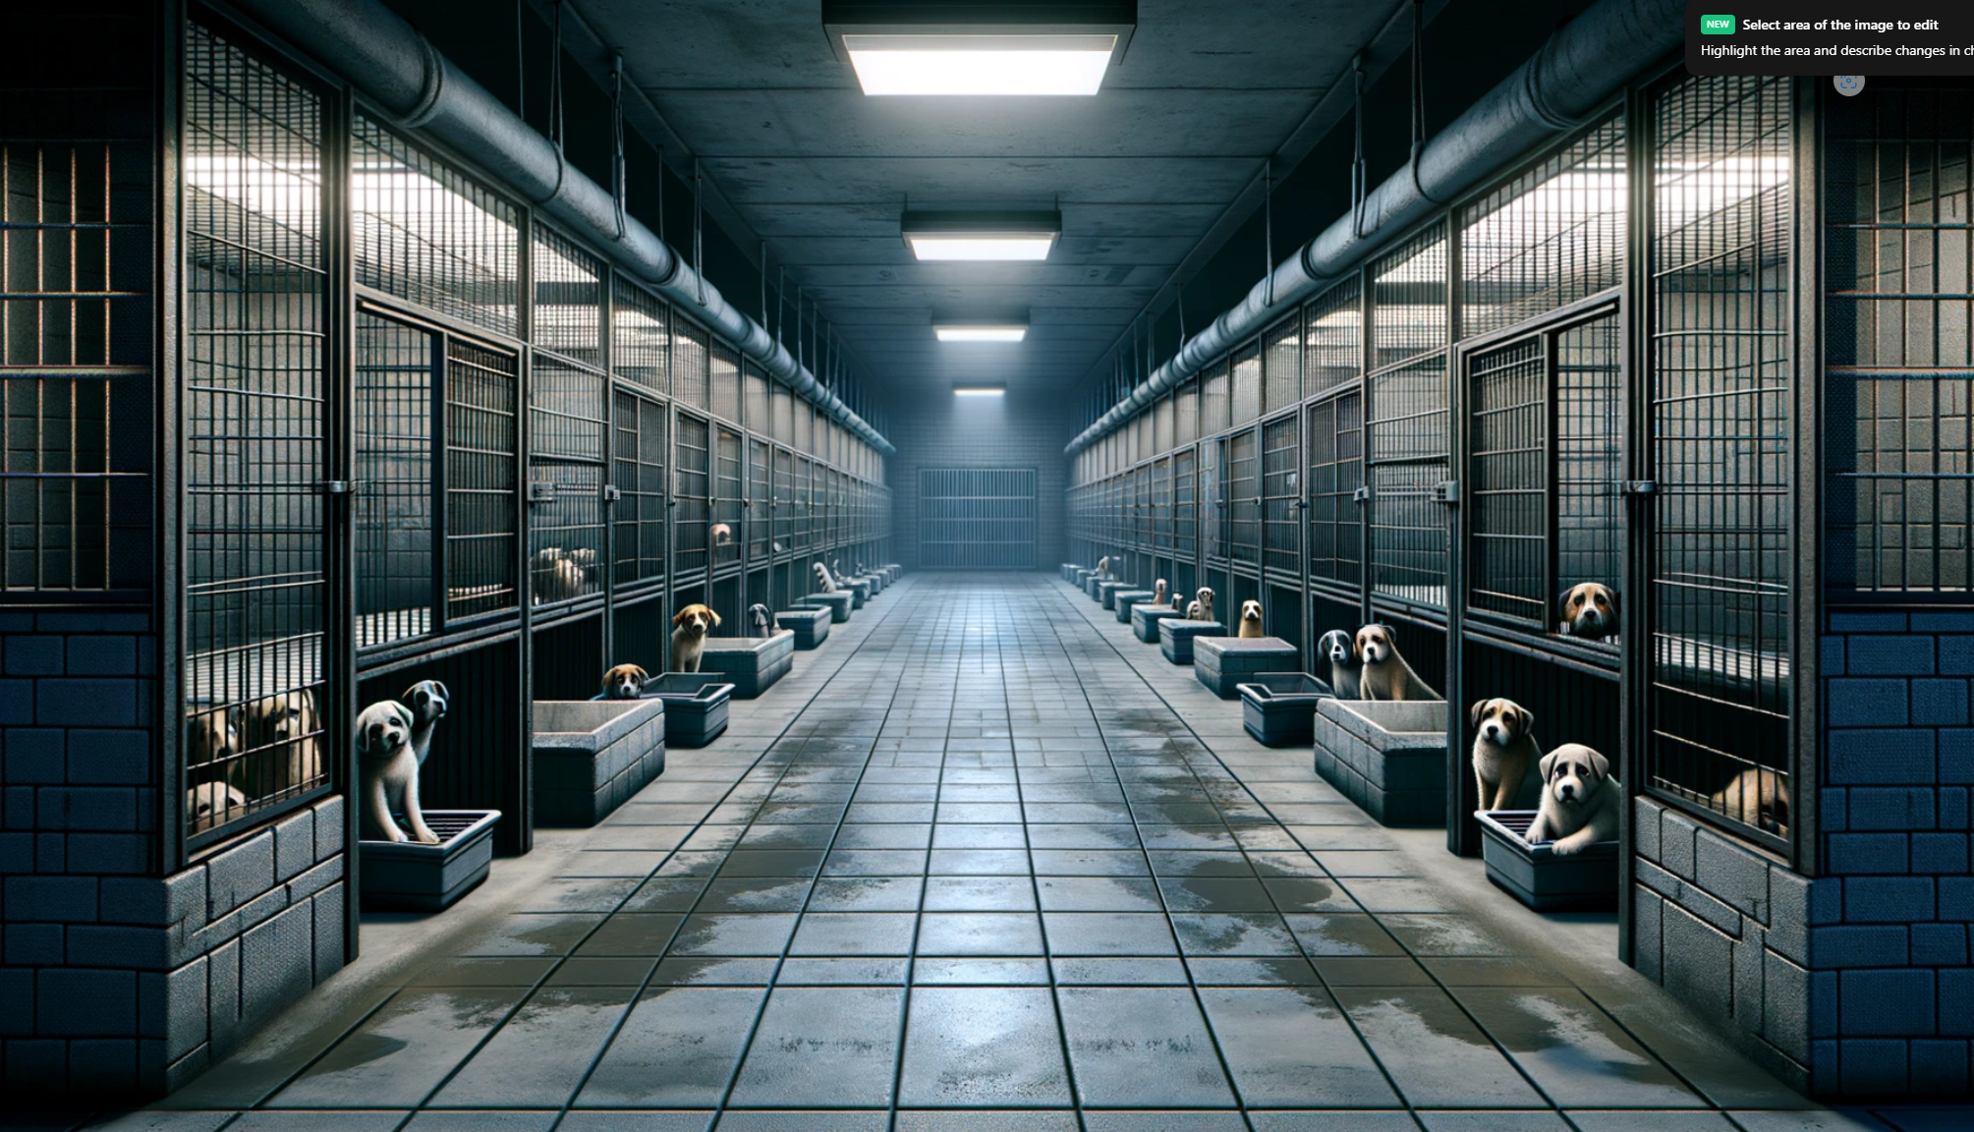
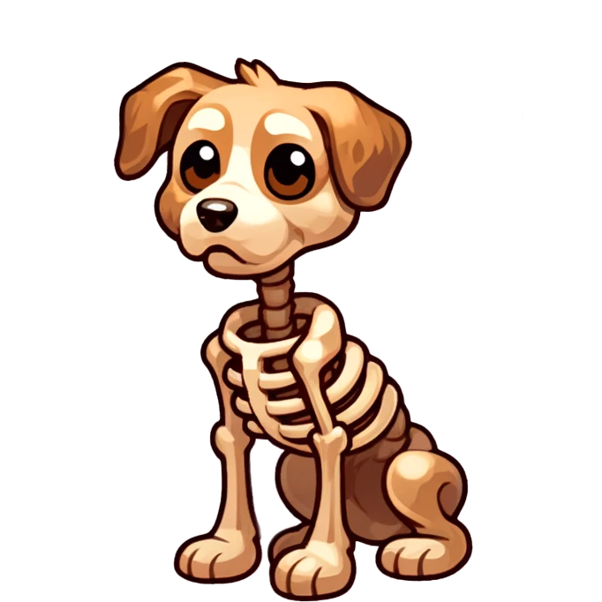

Details
Doggo / Nogo
This game was designed by psychologists to accurately assess your cognitive reflexes. After each level, you will be told how well you did compared to others.
By playing, you agree that your data will be anonymously stored for scientific research. Read the full consent form [here]
Sound of cold metalic doors opening
Dog whining
You are an investigator tasked with bringing down criminals that mistreat animals.
During your last raid, your hear something.
You decide to take him home, and name him…
Ready?
Press ↓ to start
Doggo
Doggo is in need of urgent care and feeding.
Help him get as many bones as possible by pressing the down arrow (↓) as fast as possible.

Slide 35

PAST PRESENT
Demo V0.1

Slide 36
Why Measure Processing Speed?
Fundamental cross-domain « ability » (« fluid intelligence »)
« Ability » per se vs. enabler of efficiency
Permeates most cognitive tasks
Can be measured as such with simple reaction time tasks
Rarely assessed as such. Why?
Boring and long tasks
Aspecific cognitive mechanism
Is measured concurently in any tasks with response time / time constraint
Psychologists typically interested in higher-order mechanisms
Even if processing speed is not the focus of interest, isn’t it important to measure it to « control » for processing speed differences?
Neuropsychological framework of « contrast » paradigm
Cronbach’s merger (Rouder)
Issue: Amplifies noise
See MindPulse: https://www.frontiersin.org/journals/neuroscience/articles/10.3389/fnins.2021.650219/full
https://www.tandfonline.com/doi/full/10.1080/23279095.2024.2307413
How can you use our game?

Slide 37





Reusability and Integration
Simply embed the link to a JsPsych / Qualtrics experiment
Programmable settings via URL variables (e.g., N-trials, what levels etc.)
Data
Data is stored in a private OSF repo via datapipe
CALL FOR COLLABORATORS

Slide 38
2. Validation

Slide 39
Summary
Doggo/Nogo is x2 times more fun
It is is 3.4 times more reliable than a traditional task (i.e., SD(RT) is 3.4 times smaller)
Traditional task needs x1.6 more trials to reach similar levels of reliability
Notes:
Very useful improvements in clinical populations or children

Slide 40
3. Computational Modelling

Slide 41

What’s Next?

Slide 42
Studies
Study 1: Validation of the Task
Compare gamified vs. Stripped RT task
Questions about duration perception « how long did you play for? »
« How much would you be annoyed if you had to do the task again? »
Statistical power - How many trials in each phase
Run experiment with high number of trials & Analyze convergence
Start with "empirical indices" mean and median SD MAD and see whether more trials are needed for model-based indices and what's the correlation between them
Once we have full best mixed model (from which we get the ground truth for each ppt):
compute individual models for each participant for i number of trials, and plot the SD of the estimates as well as the median - ground truth
compute the mixed model iteratively and compute reliability of random effects for each n trials
Reliability
Test-retest with delay
Study 2: Reliability & Validity
Improved reliability via prediction of estimates based on other scores (e.g., simple RT)
Clinical groups (ADHD)? Aging?
Ask Lucie (« cognitive training »)
Personality
IQ / Fluid intelligence
Emotion regulation
Neurophysiological Determinants
Cardiac phase
HRV correlates
EEG

Slide 43
Improvements
Hold-Release RT procedure
Simple Releasing Reaction Time Task: Compare classic RT press procedure with “Holding” procedure (https://www.frontiersin.org/journals/neuroscience/articles/10.3389/fnins.2021.650219/full)
The dog jumps to get the bone
Forced-response method
https://www.researchgate.net/publication/371046046_The_Forced-Response_Method_A_New_Chronometric_Approach_to_Measure_Conflict_Processing

Slide 44
Storyboard
Intro: Rescuing sad Doggo from a shelter
Level 1 (Simple RT): Doggo gets fed and becomes fat
Level 2 (Motor decision): Introducing Nogo
Level X (Stop signal): Doggo is too fat and starts a diet
…

Slide 45

Level 2: Motor Response Choice
457
Nogo sneaks in the back alley of a Japanese restaurant and tries to catch the fishbones. He must eat them « tail first » otherwise it hurts.
Phase 1: Response Choice – Association creation
Same as previously but different sprites / animations / sounds
Random color association
Cheese shape?
Fish color/shape (Nogo is japanese and loves sushi)
Phase 2: Response Choice – Associative
Phase 3: Response Choice conflit : Simon task
Conflict
457
457
457
457
Low Conflict
457
Notes:
https://www.sciencedirect.com/science/article/pii/S0010028520300049
Evolution: Nogo gets a cool hat made out of fishbones (pope’s hat) and a bowtie made of bones

Slide 46

Level 3: Response Inhibition (Stop signal)
457
Doggo is too fat and starts a diet
Stop Signal Task (SST)
Verburggen et al. (2019)
Use 2-choice task (not too simple)
¼ stop trials
Adaptive SSD
Linear probability vs. Standard staircase
N trials
« Our novel simulation results (see Figure 2 and Appendix 2) indicate that reliable and unbiased SSRT group-level estimates can be obtained with 50 stop trials (with 25% stop signals in an experiment, this amounts to 200 trials in total). »
Notes:
A consensus guide to capturing the ability to inhibit actions and impulsive behaviors in the stop-signal task | eLife (elifesciences.org)
SSD adaptation following a linear probability model:
# Example vectors x <- c(1, 2, 3, 4, 5, 6) error <- c(0, 0, 1, 0, 1, 1) # Step 1: Calculate the means of x and y x_bar <- sum(x) / length(x) y_bar <- sum(y) / length(y) # Step 2: Calculate the slope (b1) numerator <- sum((x - x_bar) * (y - y_bar)) denominator <- sum((x - x_bar)^2) beta1 <- numerator / denominator # Step 3: Calculate the intercept (intercept) intercept <- y_bar - beta1 * x_bar # Print the coefficients (Compare with lm(error ~ x)) intercept beta1 # Make prediction about value that generates y=0.5 x = (0.5 - intercept) / beta1 x plot(x, error) # Plot the data abline(intercept, beta1) # Plot the regression line) lines(c(x, x), c(0, 0.5), col='red') # Plot the vertical line

Slide 47






Flanker Examples

Slide 48

Level X: Perceptual Control (Flanker)
Conditions
Varying degrees of conflict
Double shot condition (Kucin, …, and Heathcote, 2023)
>><>> : First answer following the central stim, and then following the underlined stim
Diagonal? (double response = up + right)
« Spatial stroop » (Viviani et al., 2023)
Perifoveal is the best

Slide 49


Level X: Attentional Control (ANT)
Conditions
No cue
Uninformative cue
Valid cue
Incongruent cue
457
457
457

Slide 50

The Mouse King declares war on Nogo!

Slide 51





Level X: Switching
Nogo is captured by the Tetramice (officers of the Mouse King)
And must give them cheese. But they are picky!
Phase 1: only above
Phase 2: only below
Phase 3: Sequential
Phase 4: Random
Phase 5: Random reversals (left-right/up-down)
2
Odd/Even
Small/Big
Rule Switching (when sequential)
Rule Switching + Reactivation (when random)
How to adapt it to non-verbal?
Round cheese
Spiky cheese
or
or
Hole cheese
Rotten cheese

Slide 52






Level X: Perceptual Control (Illusion)

Slide 53



Level X: Working Memory
Complex Updating: Memory game
Span: Reproduce the dance combo
Vary time between encoding and exécution
Then, in reverse
N-back

Slide 54
Cognitive Statistical Models for
Computational Neuropsychology

Slide 55
Neuropsychology
Topic: Study of the relationship between the brain and behaviour
Method: Measurement of behaviour for inference about the brain
Domains: Fundamental (understanding the relationship) and Applied (i.e., clinical neuropsychology: usage of the knowledge to diagnose and rehabilitate cognitive deficits)
Problems:
Relies on outdated models of the brain
Relies on unreliable psychometric tools and paradigms
Relies on suboptimal quantification and classification methods
Computational Neuropsychology
New tasks that target specific cognitive processes based on newer brain theories
Using new computational approaches to estimating parameters
Example: Decision Making Models

